Slide 1
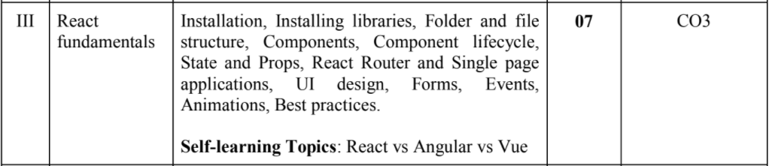

Slide 2
References:
https://reactjs.org/tutorial/tutorial.html

Slide 3
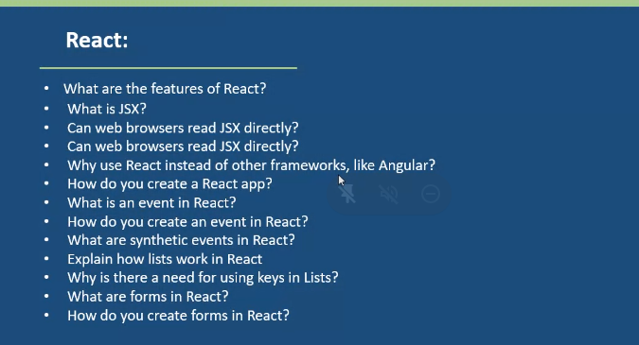

Slide 4
Everything related to react is available
https://reactjs.org/
https://classic.yarnpkg.com/en/docs/install/#windows-stable
App1 zip file from sir:
https://drive.google.com/file/d/15bZJOE-_VNqX5PuyM5NDiZUD-B10tOJq/view
App1 zip file alternate link:
shorturl.at/ADNZ5

Slide 5
What is ReactJS
ReactJS is a declarative, efficient and flexible JavaScript library for building reusable UI components.
It is an open-source, component-based, front-end library which is responsible only for the view layer of the application. React is a declarative, efficient, and flexible JavaScript library for building user interfaces. It lets you compose complex UIs from small and isolated pieces.
It was initially developed and maintained by Facebook and later used in its products like WhatsApp and Instagram.
It is responsible for managing the view layer for both web and mobile based applications. The declarative view makes your code more predictable and easier to debug.
What ReactJS used for?
React.js is an open-source JavaScript library that is used for building user interfaces specifically for single-page applications. It's used for handling the view layer for web and mobile apps.

Slide 6
Features of ReactJS
JSX
Components
One-way data-binding
Simplicity
Performer
License
Virtual DOM
JavascriptExpressions

Slide 7
ReactJS Installation
Install NodeJS and NPM. They are platforms you require to develop ReactJS applications.
Install React using the npm package manager.
npm install -g create-react-app
Create a new React project using create-react-app command
create-react-app reactproject
We can combine the above two steps in a single command using npx. The npx is a package runner tool which comes with npm 5.2 and above version.
npx create-react-app reactproject
After you complete the installation process, you can now start the server.
npm start
OR

Slide 8
NPM :- NPM will play an important role in setting up the react as well as play an important role in installing packages and libraries which we need in our project in later released .
Let’s see if we are working on any project and if we need some 3rd party library to be installed then we have NPM to install that.
Whenever you install node on your system npm comes with node.
Along with npm , npx command is used, which is similar to npm.
NPM is largest software registry:-
Ex:- If you are creating multiple projects,and multiple projects are using same components or same libraries, now one of the drawback will be that if you duplicate the code in all of the projects then you will have to rewrite the same code again and again, so how can you avoid that,
Instead of duplicating the code again and again you can create your NPM registry and you can publish your component over their. Let’s say if we have multiple projects, and the same multiple projects having the same piece of code that can be componentized, that can be stored as NPM registry and installed as library whenever required. So, this is the main usage of npm and npm registry.

Slide 9
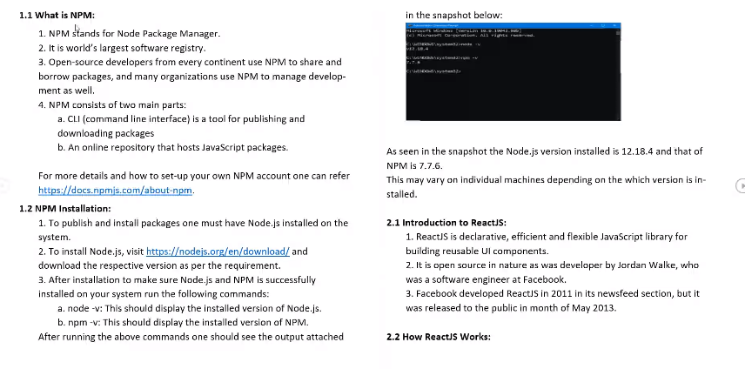

Slide 10
All about npm
:https://docs.npmjs.com/about-npm
Node installations:
https://nodejs.org/en/download/

Slide 11
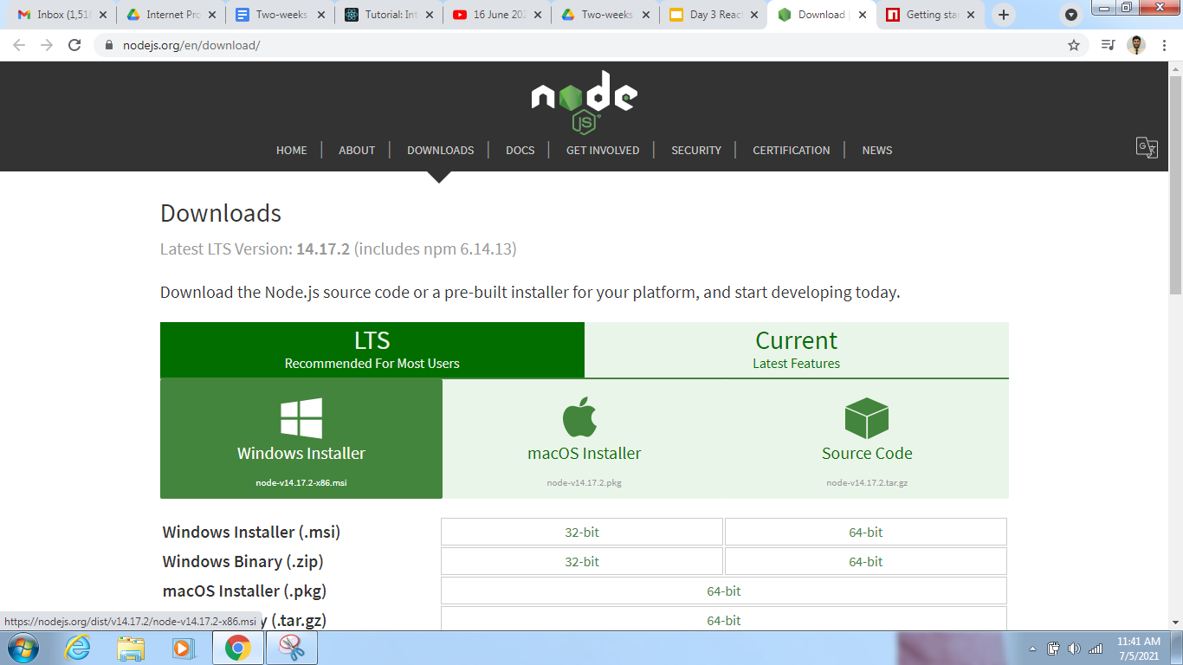

Slide 12
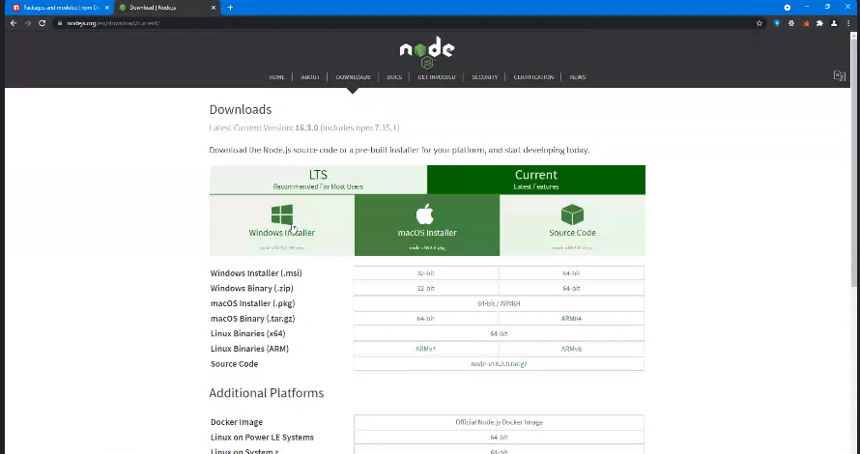
https://nodejs.org/en/download/

Slide 13
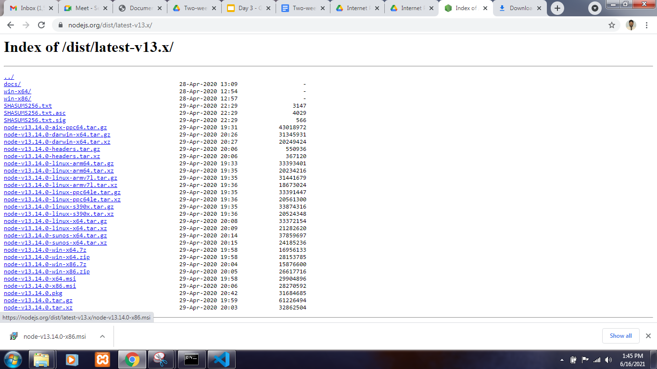

Slide 14
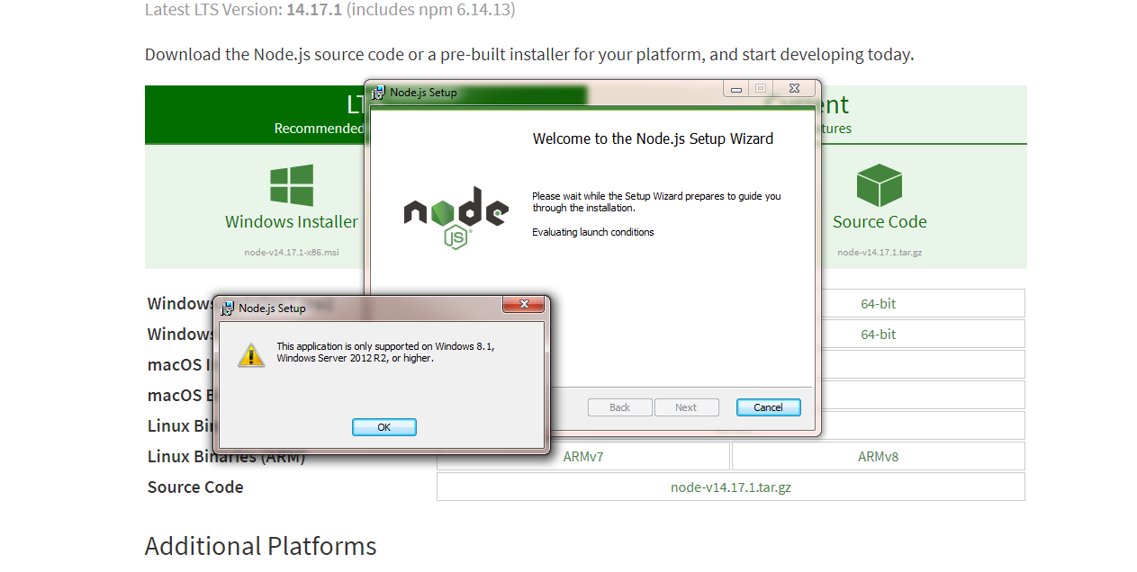

Slide 15
Nodejs is global installed. We can easily find it’s version from cmd prompt w/o giving any path.

Slide 16
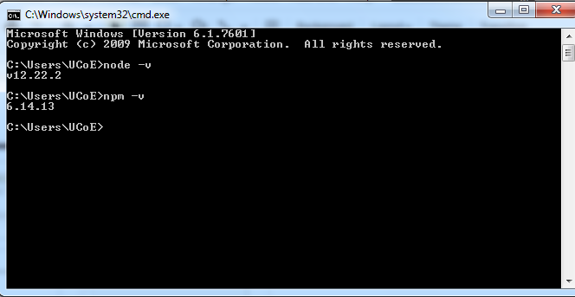
Execute below command in cmd prompt:-
node -v
node --version
npm -v
npm --version

Slide 17
React js is a library not a framework, which helps you to develop UI component.

Slide 18
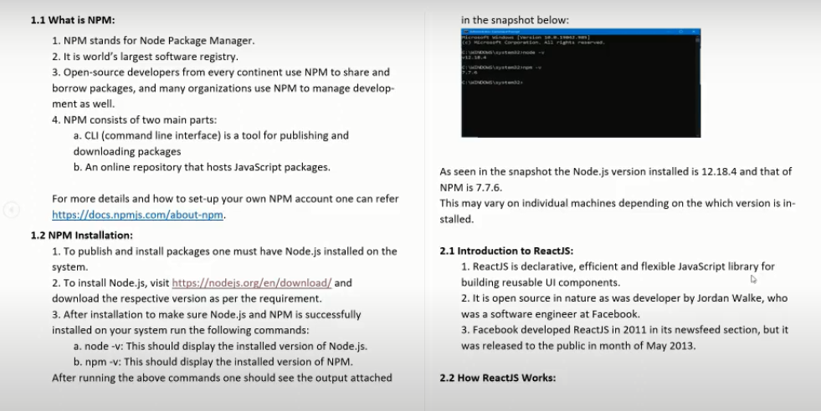

Slide 19
When you go to any website, your website is rendered inside a DOM. There is a Browser DOM and inside a Browser Dom you see your website either form, simple tag etc.
Basic advantage of React over other libraries and frameworks available in the market like angular, view is that it has virtual dom.
What do you mean by Virtual Dom?
You have couple of components or files available with you and you change any of the file so what really happens is that, when you change any of this file that time your Browser Dom should get updated. This eventually happens with rest of the libraries and frameworks. But what react does is before directly updating the Browser Dom itself React already have virtual dom itself at a place somewhere in your browser so what it does, it just try to compare the changes with actual browser dom which is available and it only replaces those file which are being changed.That’s an advantage over here. The reloading and application which is being served on your browser is much faster compare to other techniques. That’s makes it more popular over other frameworks available in the market.

Slide 20

Consider this is your website and your website consist of various components. Now the multiple components can be a,b,c,d etc.
We have one component over here which is present in our website, so this component is been updated, because of new data coming into your website or someone registering your portal or anything. So this component got updated.
Now React does it to compare it with REAL DOM which is present in your browser. So virtual DOM is highlighted by red, which is been change and REAL DOM will be highlighted by green color.
There is a manipulation between virtual dom and real dom. So what react does instead of rendering entire website, it will just reload the component,which is been change which we can see by green color. This become faster eventually. .

Slide 21

When an indirect relationship causes functional dependency it is called Transitive Dependency.
If P -> Q and Q -> R is true, then P-> R is a transitive dependency.

Slide 22
Project setup
https://yarnpkg.com/
This is similar to npm, but the advantages are quite stable, it’s quite faster then npm, so this also another package which we can use for creating our react project.
Now we have to make sure that yarn is also globally installed into our system present inside environmental variable so that we don’t get any specific errors. Two ways to install yarn in our system.
1) Using NPM
Alternate method (We are not preferring that)
2) Using Chocolaty

Slide 23
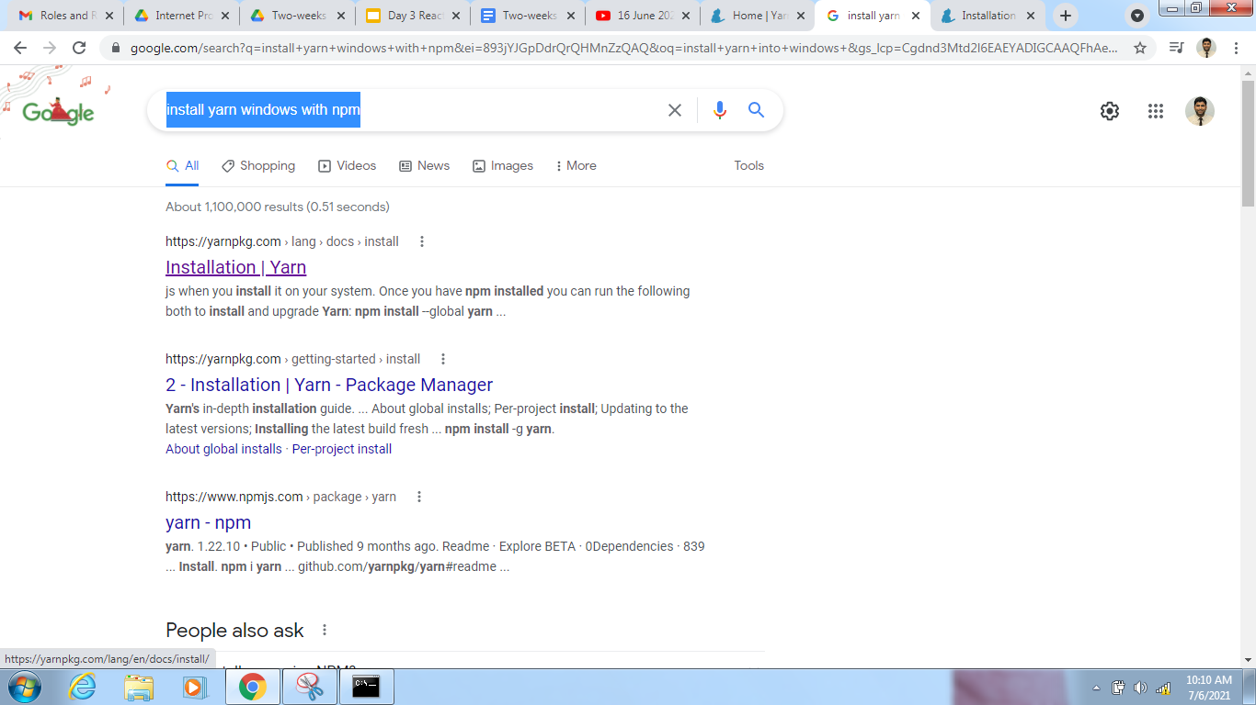

Slide 24
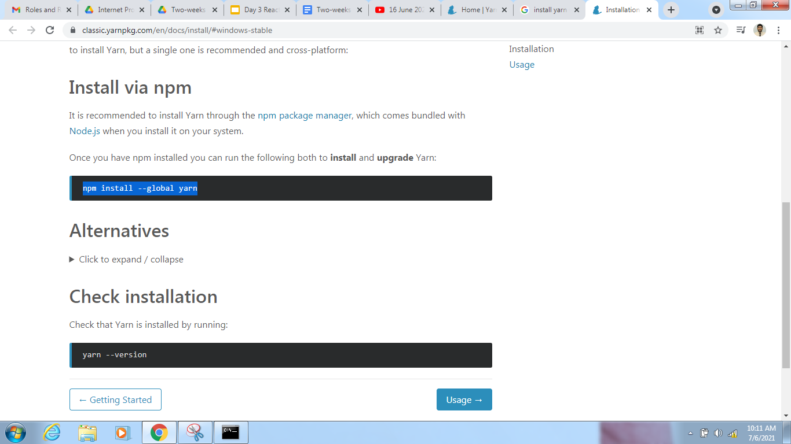

Slide 25
Install via npm
It is recommended to install Yarn through the npm package manager, which comes bundled with Node.js when you install it on your system.
Once you have npm installed you can run the following both to install and upgrade Yarn:
npm install --global yarn
Check installation
Check that Yarn is installed by running:
yarn --version

Slide 26
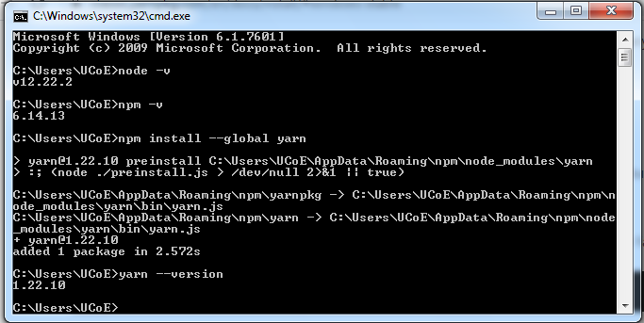

Slide 27
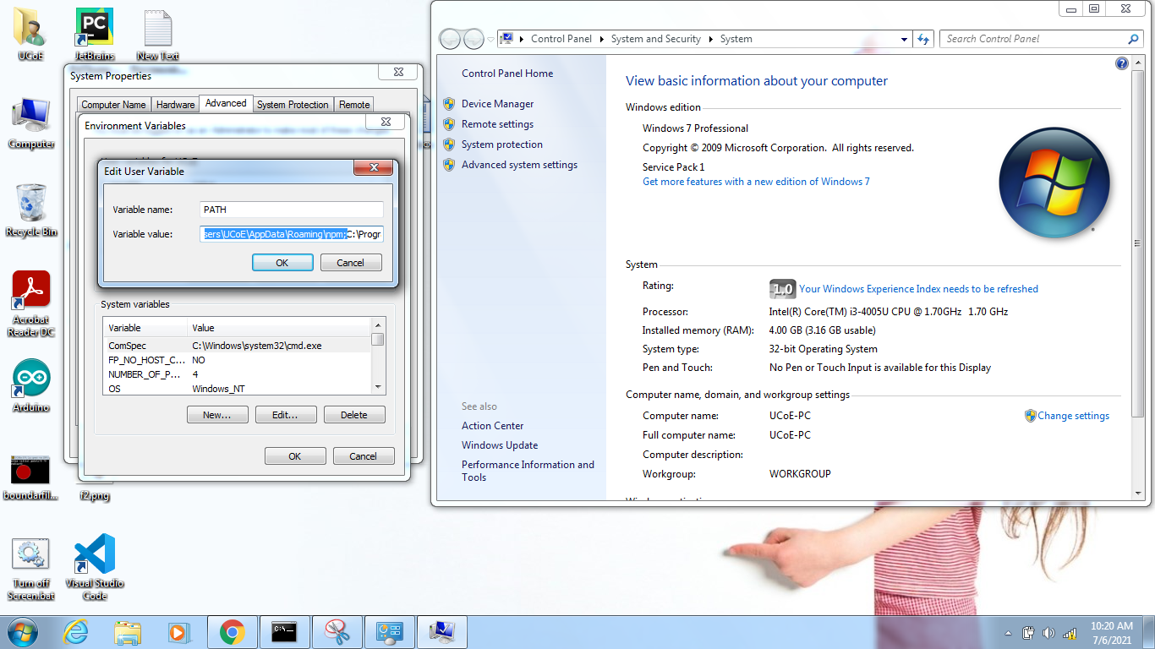
If it is giving error in cmd prompt with respect to version or environmental variable related then again we need to set proper environmental variable path.
For ex:- C:\Users\UCoE\AppData\Roaming\npm;

Slide 28
Optional Alternate method

Slide 29
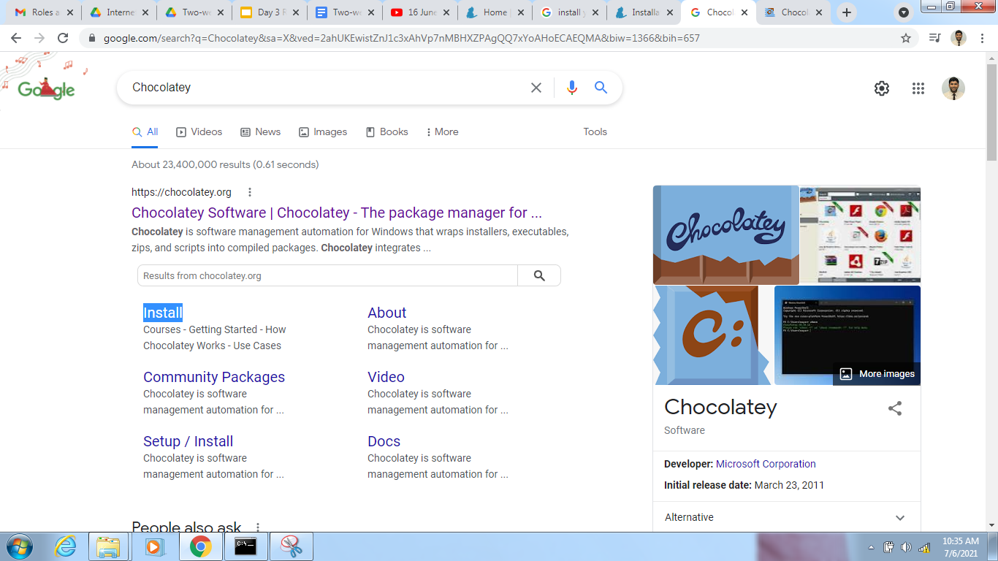
2nd Method ..go to install
https://chocolatey.org/install

Slide 30
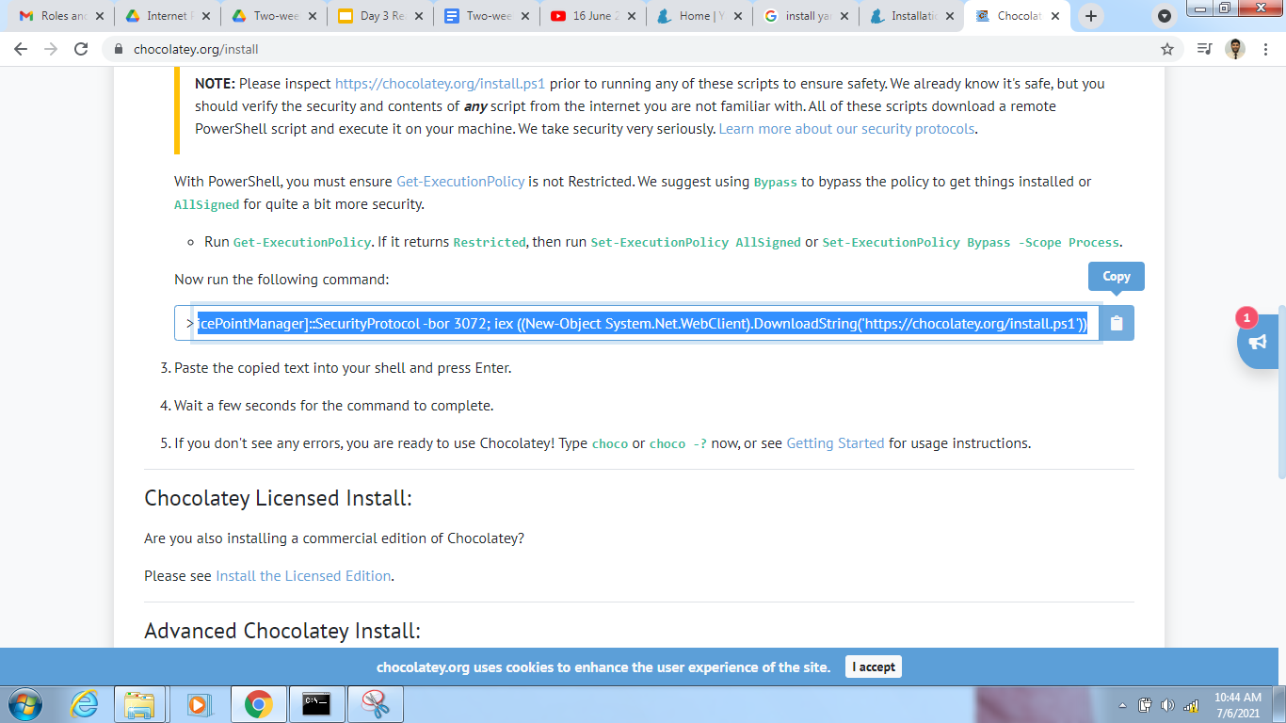
This is also a package manager which is used to install couple of packages on your system by adding it to your environmental variable.

Slide 31
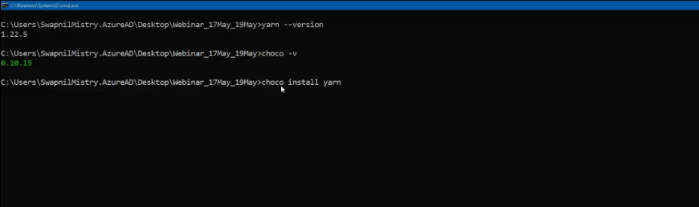
This command need to be executed in powershell command prompt.
This will install CHOCOLATEY in your system.

Slide 33
We can start setting up our react project now, Now either you use yarn or npm for creating your react project.
Put this command
Using yarn :-
yarn create react-app app1
Or
Using npm :-
npx create-react-app app2
(https://docs.npmjs.com/cli/v7/commands/npm-install)

Slide 34
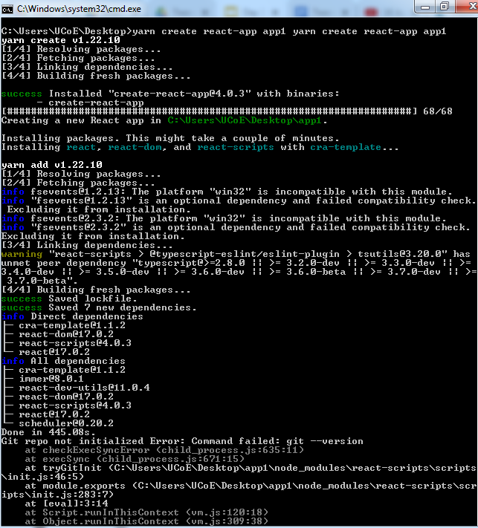

Slide 35
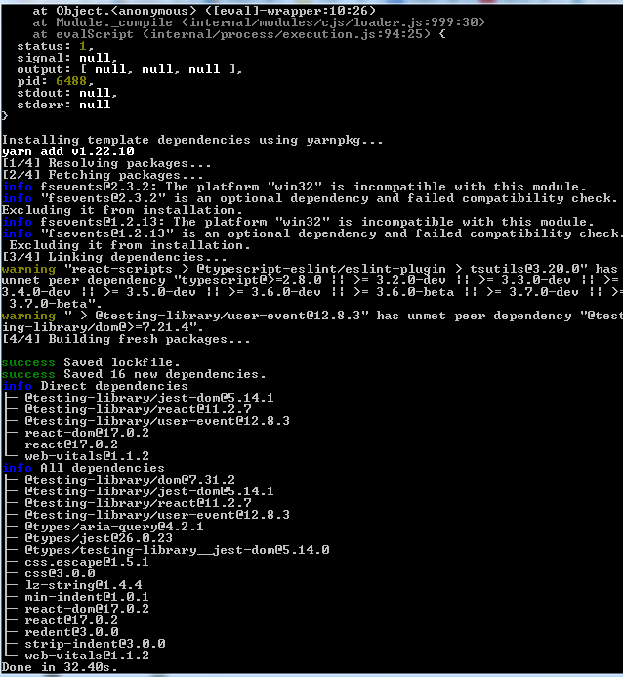

Slide 36
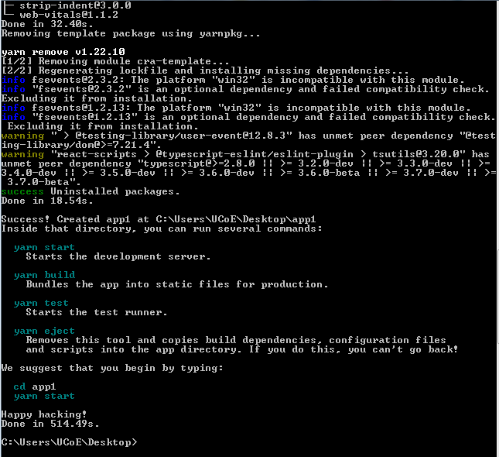

Slide 37
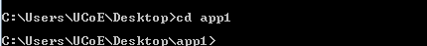
Now goto that folder through cmd prompt or by directly through folder url by putting cmd over there

Slide 38
To open visual studio code window for current project use below command

Slide 39
Open package.json file in editor
For whom the app1 project is not created can refer below zip file
App1 zip file from sir:
https://drive.google.com/file/d/15bZJOE-_VNqX5PuyM5NDiZUD-B10tOJq/view

Slide 40
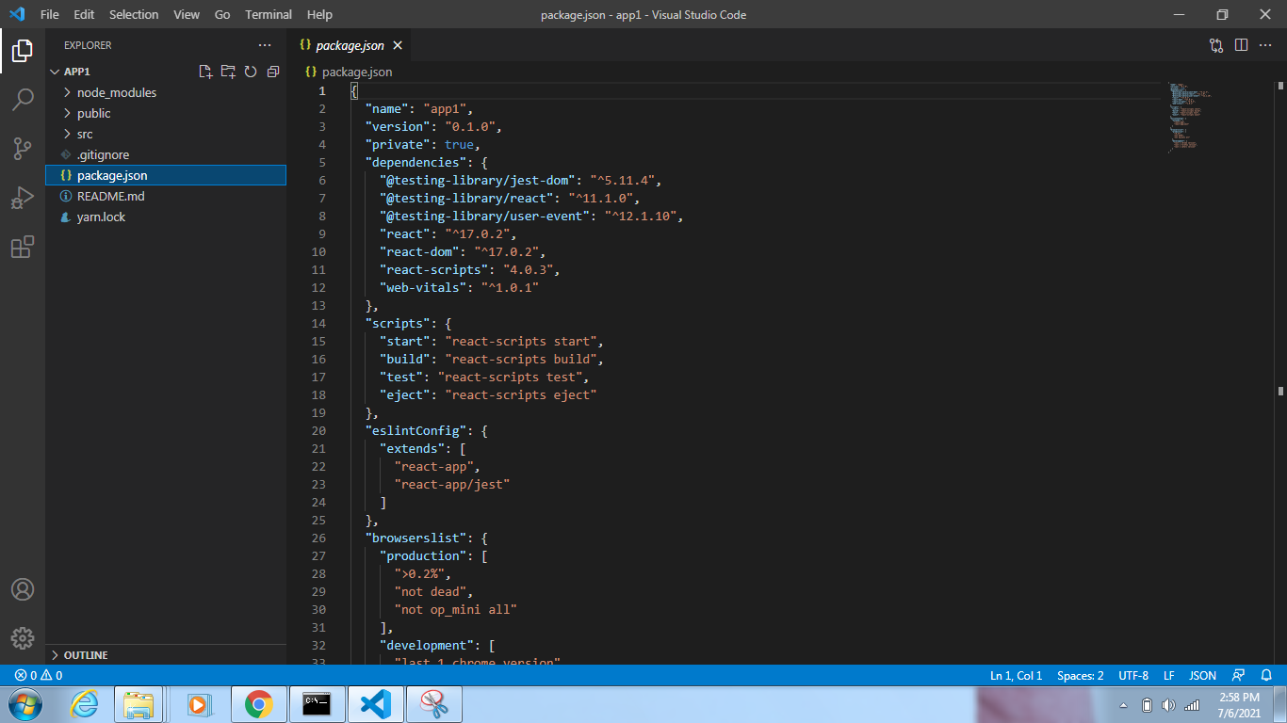
Folder and File structure.
Project structure on the left side of the screen

Slide 41
Folder and File structure
In React application, there are several files and folders in the root directory. Some of them are as follows:
Node_modules:- It contains the React library and any other third-party libraries needed. Folder contains couple of libraries that are installed while creating this basic react project also it keep track of all the files which our project is eventually using. for exL- react-dom library.
Public:- It holds the public assets of the application. It contains the index.html where react will mount the application by default on the the<div id= “root”> </div> element. Also it contains all the static files that we need to add/comprises in our project. Like images, svg or audio files etc. also couple of icons are available here like favicon.ico.

Slide 42
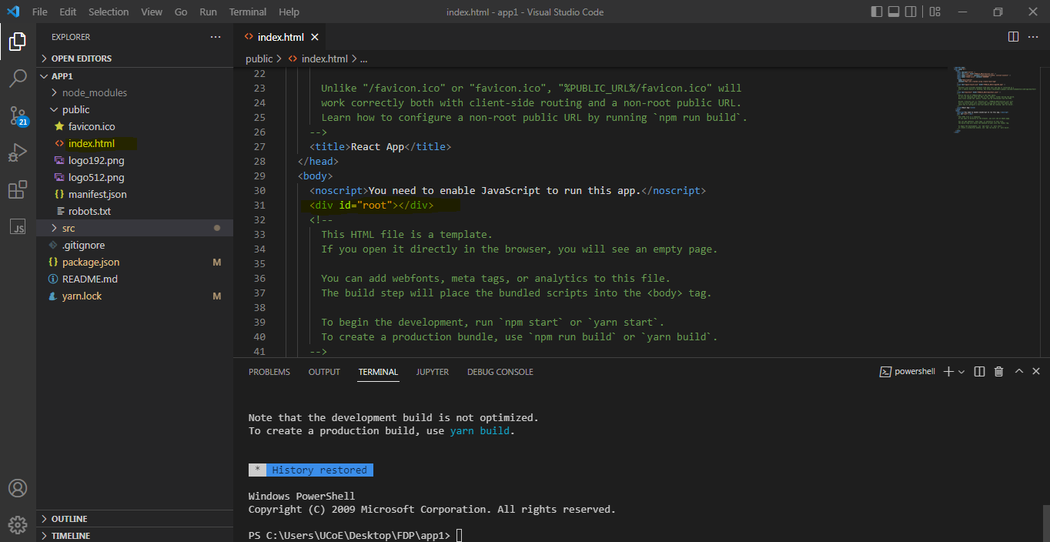
It contains the index.html where react will mount the application by default on the the
<div id= “root”> </div> element.

Slide 43
3) src(source) Folder:- It contains the App.css, App.js, App.test.js, index.css, index.js etc. files. Here, the App.js file is responsible for displaying the output screen in React. It consist of all the components and the folder which our project is having for displaying the same on the DOM.
4) .gitignore file :- It is a files used to exclude files and folders from being tracked by GIT. In simpler words, it means the files or folders we do not want to be committed to GIT’s project repository. Example: We do not want to include large folders like node_models
Or It is used for ignoring to push into git repository as not all the files we are putting inside git because of it’s size as well as usefulness. So the file which we don’t want to put are listed here in this file. By default they have specified couple of files we must ignore. Since node_module file is big it is available there. So all the files which you want to ignore while pushing in Gitrepository are placed here. Bydefault they have specified couple of files over here like node_modules
Whenever any error occurs while installing or debugging such a files are created in your project directory. ,
npm-debug.log*
yarn-debug.log*
yarn-error.log*

Slide 44
5) package.json:-
It holds various metadata required for the project. It gives information to npm, which allows to identify the project as well as handle the project’s dependencies. IT manages app dependencies that are present in our node_modules, along with scripts that one can run on app.
It is the most important file in your project. W/O package.json your project won’t run.
In side file 1st thing it contain is name of the project, which we have provided while creating React app, like app1.
2nd version is useful for componentanize and segregate in project. If you are getting any updates of the version then simply update it. Right now it’s 0.1.0
Private - we need to make sure that this project is private, it’s been not available to public and other users.
Dependencies are packages and libraries useful into our project. 1st 3 are related to testing

Slide 45
"@testing-library/jest-dom": "^5.11.4",
"@testing-library/react": "^11.1.0",
"@testing-library/user-event": "^12.1.10",
For ex.if you have created one project and we need some test cases for that so above 3 libraries are configured for you. There is no need to add any library to adding test cases.
Next react which is simply a library it’s not a framework, we have installed react as library and we haven’t used it as framework. Which is used for building reusable UI component across your project.
React-dom:- useful for rendering your components on our actual browser DOM.
React-scripts:- are initially created by facebook itself. Which helps to run project on your system, also helps to build your project(means whenever you want to deploy your project .on the domain, then we need something called as production , so scripts helps to build your project and do couple of other things.
Web-vital:- not a necessary file we can remove it,we might required in future but not now..

Slide 46
Scripts:- which allows us to run our project. We are provided 4 scripts as of now.
scripts": {
"start": "react-scripts start",:
"build": "react-scripts build",
"test": "react-scripts test",
"eject": "react-scripts eject"
Start :- allows us to run project on browser, It uses some package react-scripts followed by start. How your server run on your browser. What should happen when you build.
Build.:- This will build your project. This build will be in optimized production build, This will remove all unnecessary codes, all the commented code,and create a production build which is suitable for deploying on your domain.
Test:- If you write some test cases for project then we can use this command whether test cases are getting passed or not.
Eject:- we hardly used this because lots of template are already configured , but if you want to add something which is newly required that react-scripts does not provide then we can use this command.

Slide 47
We will see how to start
eslintConfig": {
"extends": [
"react-app",
"react-app/jest"
Above helps us when we are writing any wrong syntax then it will give a red arrow at beyond that variable.
"browserslist": {
"production": [
">0.2%",
"not dead",
"not op_mini all"
Above helps us whenever you build any production build so what version’s of browser your project should support, in above case we can see that all he version should be greater then 0.2%. And we do not support ( "not op_mini all") all the opera mini browsers.
"development": [
"last 1 chrome version",
"last 1 firefox version",
"last 1 safari version"
]
In terms of development what browser your project should support when you ar running and deploying,. So it’s saying last one
"last 1 chrome version",
"last 1 firefox version",
"last 1 safari version"
]

Slide 48
README.md
It provides the documentation to read about react topics.
This file usually giving brief like, different commands are available in your project, also what your project name, and what your project is responsible for doing and etc.
This file was eventually created by default template.
But if you try to create react project from scratch which is present inside advanced react then using webpack then all this files won’t be present.You have to create from scratch.

Slide 49
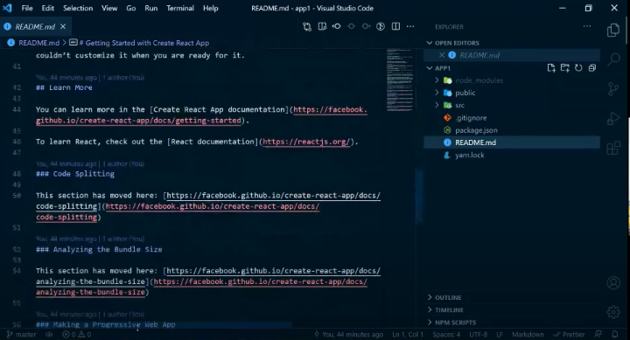

Slide 50
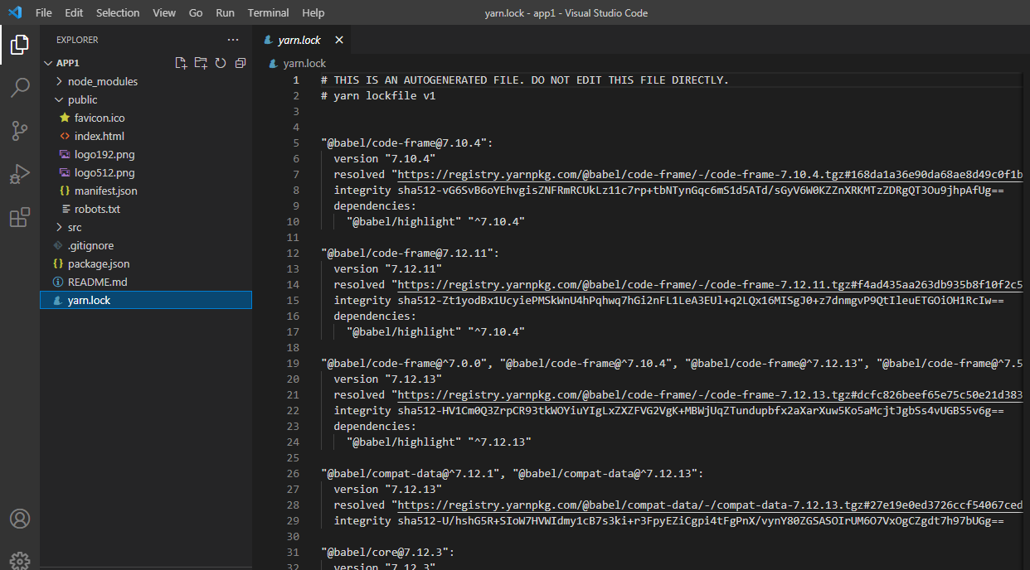

Slide 51
Then we have yarn.lock
Those who have created project using yarn they will be able to see yarn.lock
In project structure, but for the people who were using npm they will see something like packagelock.json
The purpose of this file is to keep track of dependencies which your project is using. dependencies inside dependencies .
Ex:- react is a library which we are using in package.json but what dependencies this library using. This library will also have some dependencies or some packages which we have installed for running it. So dependencies of dependencies present inside yarn.lock. If you can try to search in yarn.lock file as React then it will show many dependencies., you can see lots of things with react over here.

Slide 52
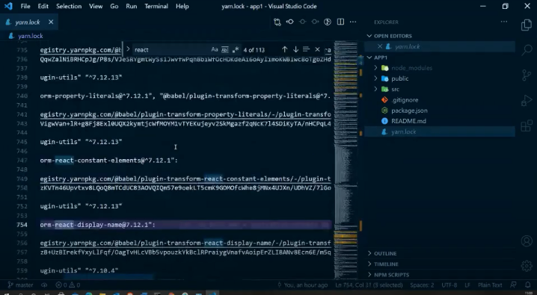
All this things are dependencies which react script is using. This is how the project structure actually looks like.

Slide 53
Now we will execute some commands
Open package.json file and open terminal
Now this command is only for those people who have created project using yarn they can use command
yarn start and
people who have created project using npm they can use command
npm start
This will run your project on local browser.
It will start my deployment server. And my new window getting popped over crome browser.

Slide 54
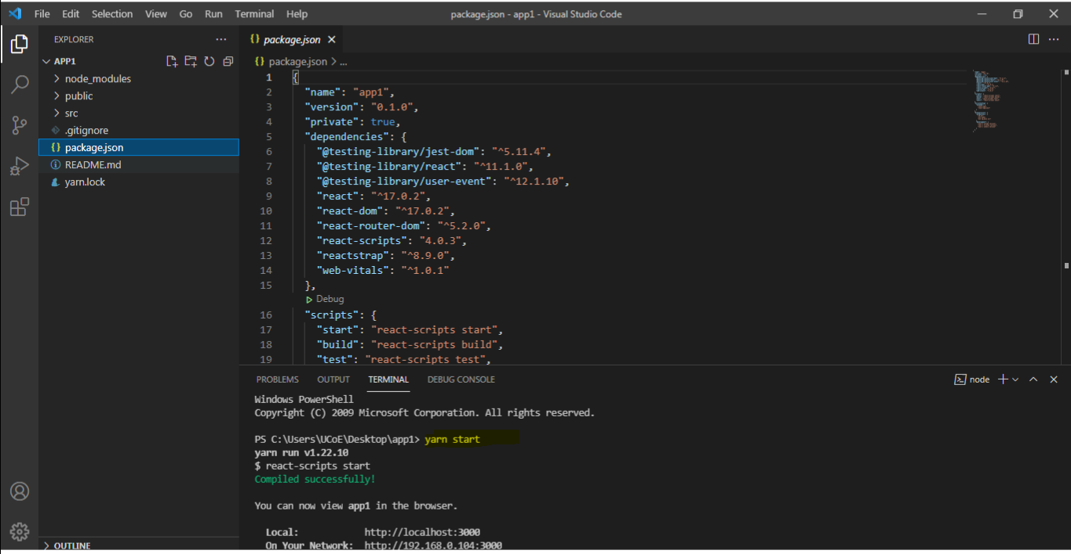
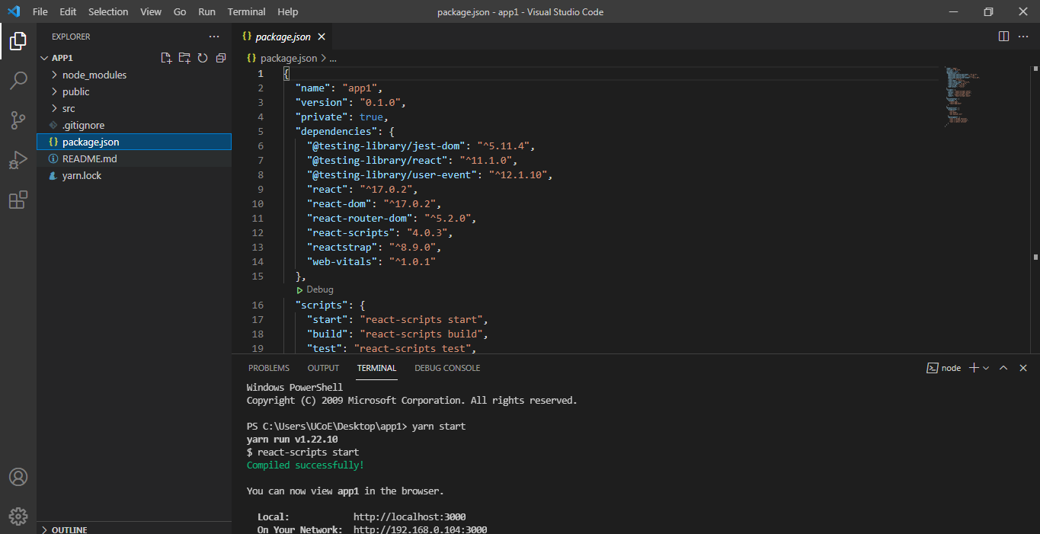

Slide 55
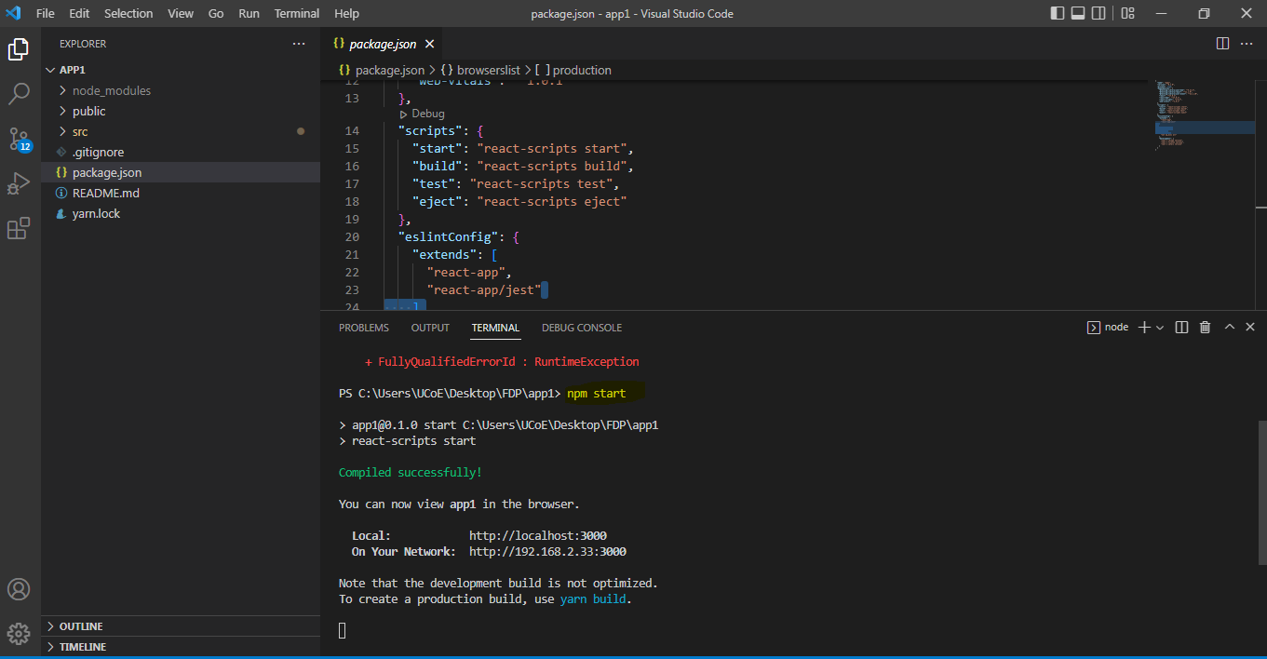

Slide 56
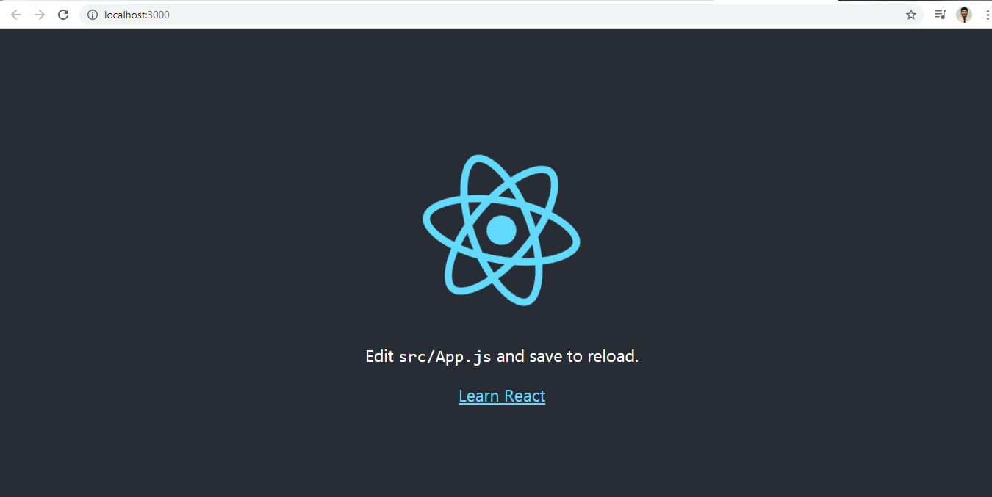
We can see the basic react template over here. With this we have successfully run our project on local server. All the contents which we have seen above will be served from app1 src files including css files, whether it’s logo or rotation, react icon all this is css file.

Slide 57
App.js:- This is the main file where you have created your component, and bunch of other stuffs available.
App.test.js:- where we have created test file, where we can run this ("test": "react-scripts test",) command.
index.js:- which file is useful for rendering item inside the dom, so we have couple of things already imported over here. So, when you try to run npm start this file gets executed first (index.js). So it check for all the imports which we need in the application. Right now we are importing this app(import App from './App';). This app is nothing but App.js.
Because we want to serve all the contents from app.js so we have imported it. And we are importing something called import ReactDOM from 'react-dom'; This is responsible for all the contents in your browser dom. So we are using ReactDOM.render() method inside render dom. And we are rendering the App <App />.
document.getElementById('root'):- which allow you to keep all the files under root tree.

Slide 58
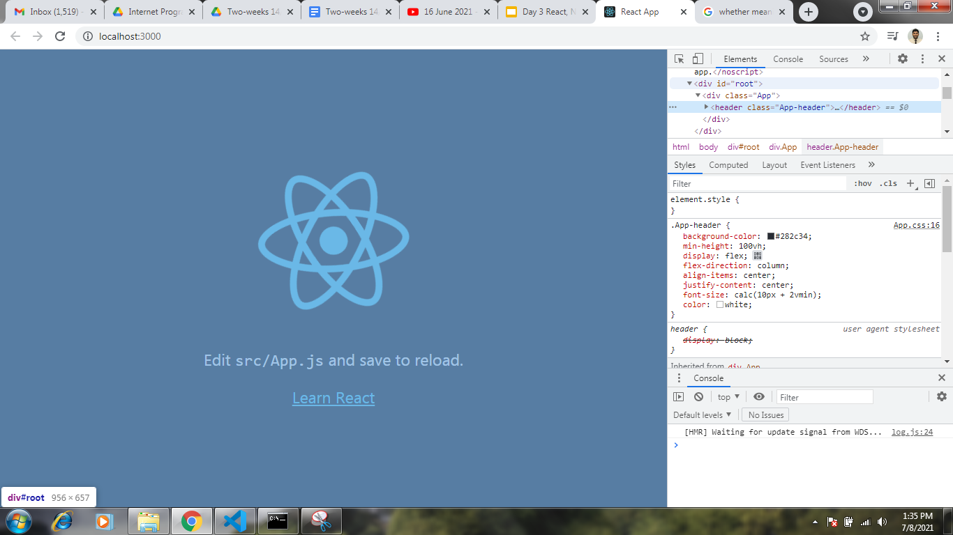
If you look it closely then we have root over here.

Slide 59
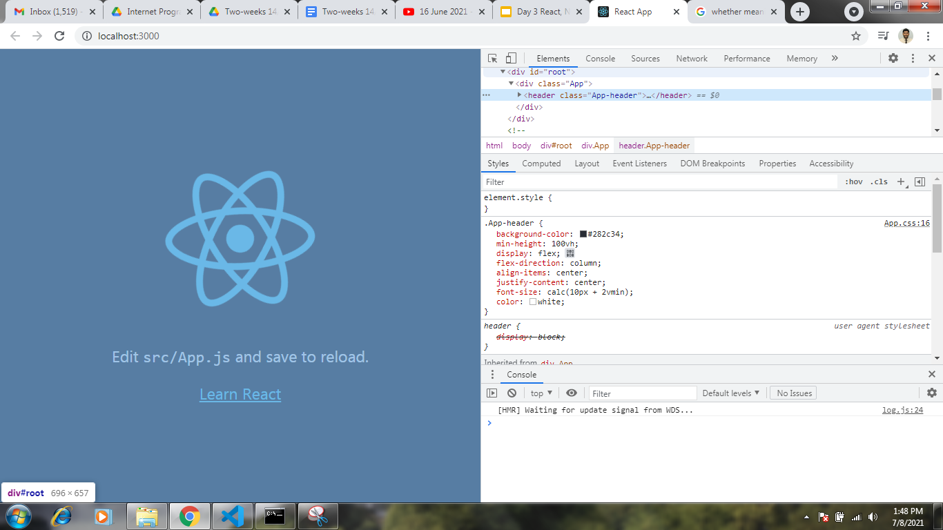
IF I open the window side by side and hover over root then my screen become blue. This is nothing but my parent tag and inside this tag we have something called as App. This is nothing but what we have seen in document.getElementById('root') and App.js file.

Slide 60
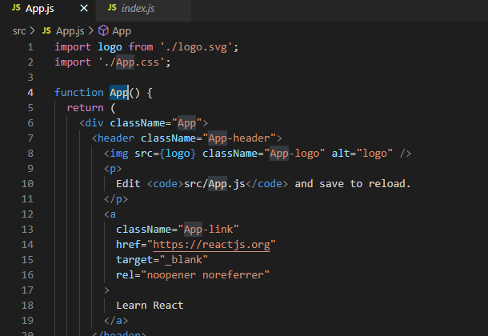
Everything present inside the function App() which is present inside the App.js will be served through document.getElementById('root'), that’s what we have seen inside browser elements

Slide 61


Slide 62
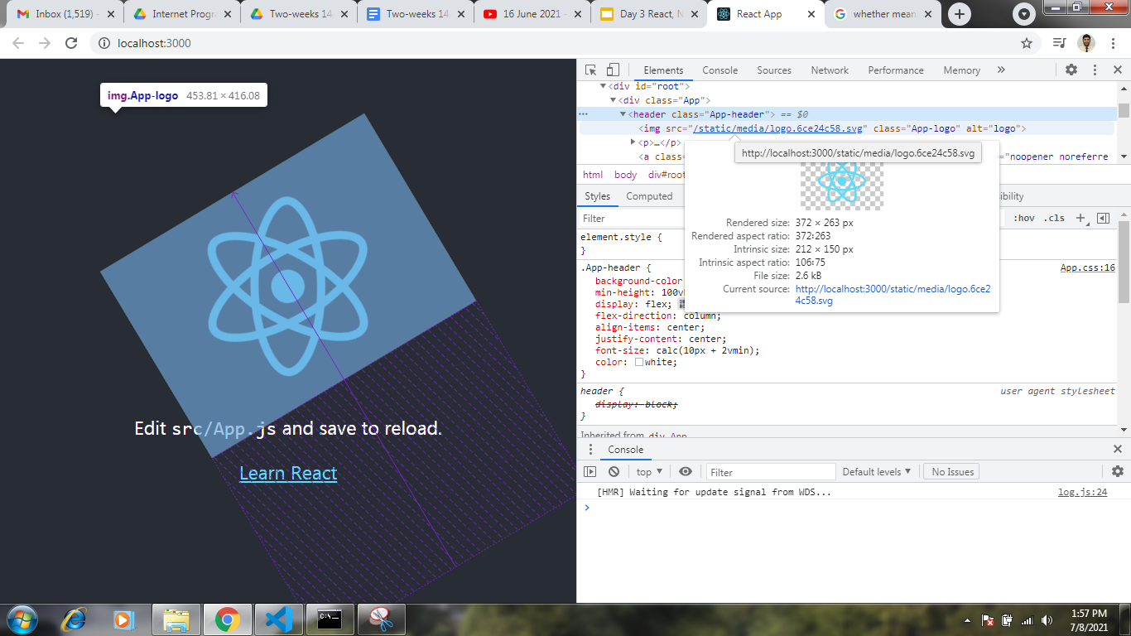
Further when you hover over img , you can see rotating image.

Slide 63
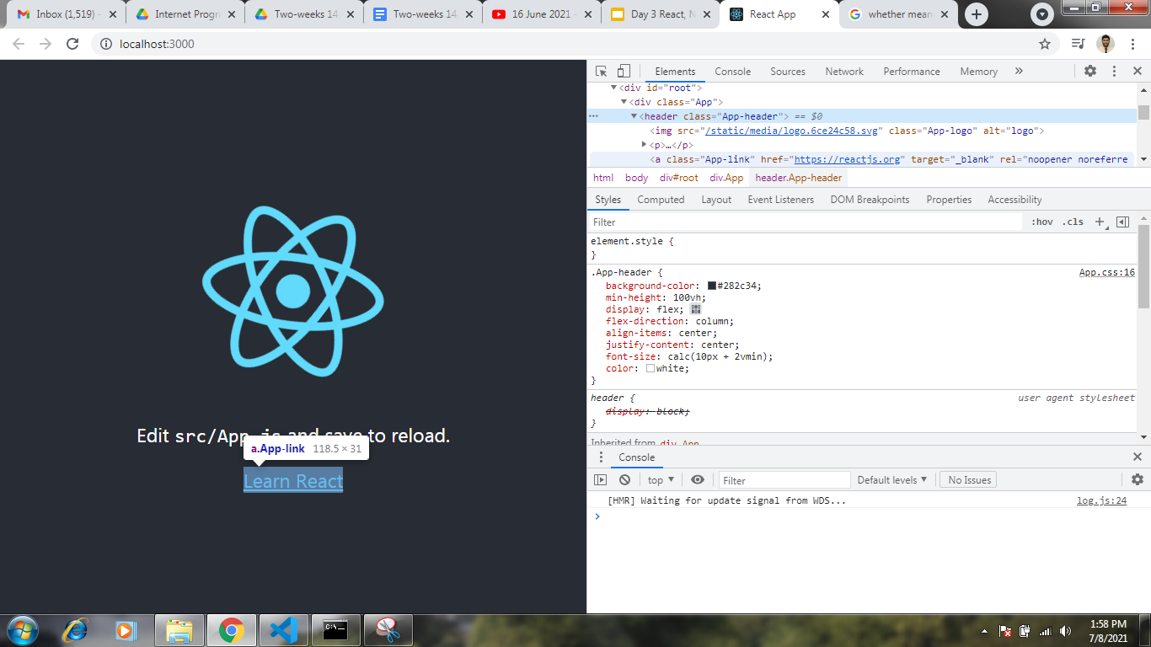
Then App link is also highlighted. That’s what we have observed in App.js

Slide 64
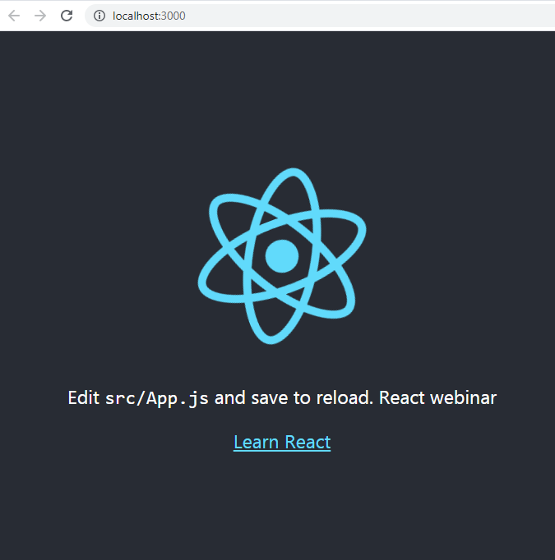
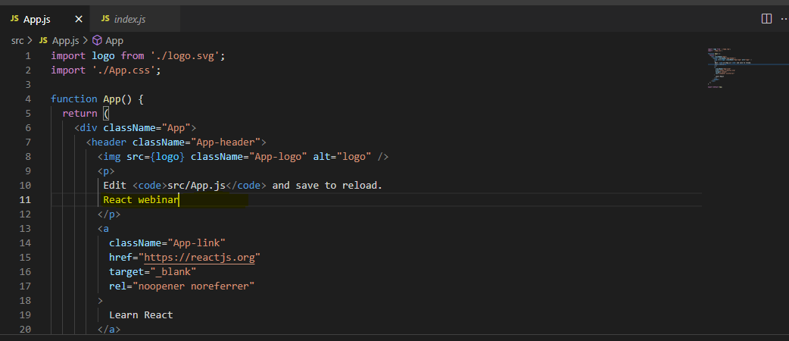
Whatever you are adding in App.js will be automatically updated in the browser.

Slide 65
Once you start the development server (http://localhost:3000/) then everything will be fine.

Slide 67
First React Project Setup
Step by step procedure to start with the first react application.
Step 1
To Start with reactJS we need to first import the react packages as follows:
import React from "react";
import ReactDOM from "react-dom";
Save the file as index.js in src/ folder
Step 2:
We will write a simple code, wherein we will display the message “Hello, welcome to ReactJS!”
ReactDOM.render(
<h1> “Hello, welcome to ReactJS!” </h1>
document.getElementById("root")
);
ReactDOM.render will Add the <h1> tag to the element with id root. Here is the html file we are having:

Slide 68
index.html
<!DOCTYPE html>
<html lang="en">
<head>
<meta charset="utf-8" />
<title>React App</title>
</head>
<body>
<div id="root"></div>
</body>
</html>

Slide 69
Step 3: Next, we need to compile the code to get the output is a browser.
Here is the folder structure
app1/
node-modules/
src/
index.js
Package.json
public/
Index.html
We have added the commands to compile the final file in package.json as follows:
"scripts": {
"start": "react-scripts start",
},
To compile the final file Run following command:
npm run start
When you run about command, it will compile the files and notify you if any error, if all looks good it will open the browser and run index.html file at http://localhost:3000/index.html.

Slide 70
Step 4:
The URL http://localhost:3000 will open in the browser once the code is compiled and display the message “Hello, Welcome to ReactJS”.

Slide 71
What is React JSX ? Dec- 2021 5-marks
JSX is an extension to JavaScript. It is a template script where you will have the power of using HTML and Javascript together.
An example of a JSX code is:
Const h1tag =”<h1> Hello</h1>”;
In React, you can write HTML/XML structure in the same file as the JavaScript code. Then, the preprocessor converts the expressions into JavaScript code. Additionally you can also manage the state changes in the dom in the most effective manner.
JSX tags includes a tag name, attributes and children.

Slide 72
Reasons to use JSX in React
It works at a more incredible speed than regular Javascript. While it translates the code to Javascript, it also performs optimization.
It makes use of components that include both markup and logic.
You can find the errors during the compilation time as it is type-safe.
You can easily create templates in JSX.

Slide 73
Expressions in JSX
Expressions are used inside curly brackets { }, and they are expanded during run time. Expressions in react are the same as javascript expressions.
import React from "react";
import ReactDOM from "react-dom";
const display = “Hello, Welcome to ReactJS!”;
const h1tag = “<h1> {display} </h1>”;
ReactDOM.render(h1tag, document.getElementById('root'));

Slide 74
https://snipper.io/s/-McIYXR6cEvW-VVXUeKE

Slide 75
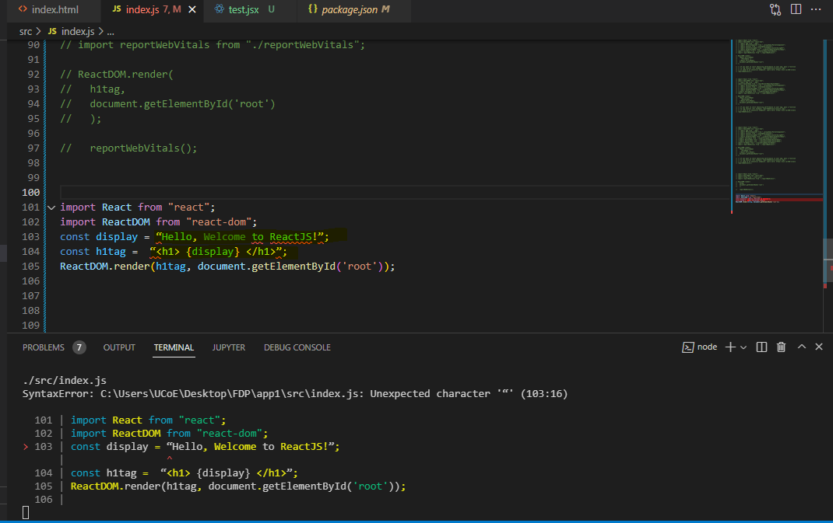
You can see that the {display} expressions is not replaced.
React does not know what to do when an expression { } is used inside the .js file

Slide 76
Let us now add changes and create a .jsx file as test.jsx
import React from "react";
import ReactDOM from "react-dom";
const display = "Hello, Welcome to ReactJS!";
const h1tag = <h1> {display} </h1>;
export default h1tag;
We have added the required code and will use the test.jsx file in index.js. We want the h1tag variable to be used inside index.js, so the same is exported as shown above in the test.jsx.

Slide 77
Here is the modified code in index.js
import React from "react";
import ReactDOM from "react-dom";
import h1tag from "./test.jsx";
ReactDOM.render(
h1tag,
document.getElementById('root')
);

Slide 78
To use the test.jsx in index.js we have to import it first as shown below:
import h1tag from "./test.jsx";
We can use the h1tag now in the ReactDOM.render as shown below
ReactDOM.render(
h1tag,
document.getElementById('root')
);

Slide 79
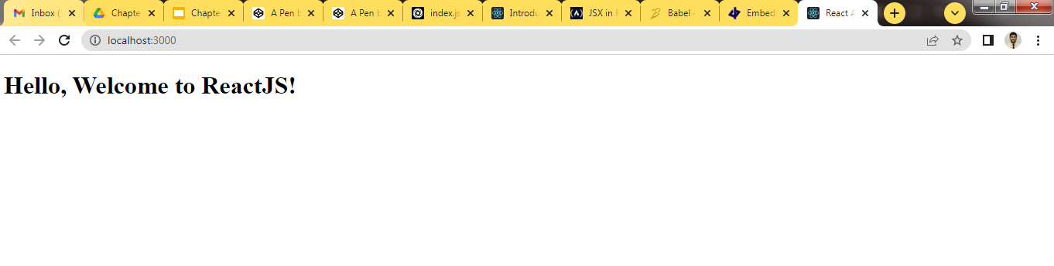

Slide 80
JavaScript XML (JSX)
https://codepen.io/pen?&editors=0010
https://codepen.io/pen/
For chapter 3. ebook
https://campusfunda.com/Users/pdfReader/MzUzNg==/5#sthash.2Lj9Nvkl.dpbs

Slide 81
Open below codepen IDE to execute JSX snippets
https://codepen.io/gaearon/pen/PGEjdG?editors=1010
Open below link to check JSX snippets
https://www.w3schools.com/REACT/react_jsx.asp

Slide 82
const element = <h1>Hello, world</h1>;
ReactDOM.render(element, document.getElementById('root'));

Slide 83
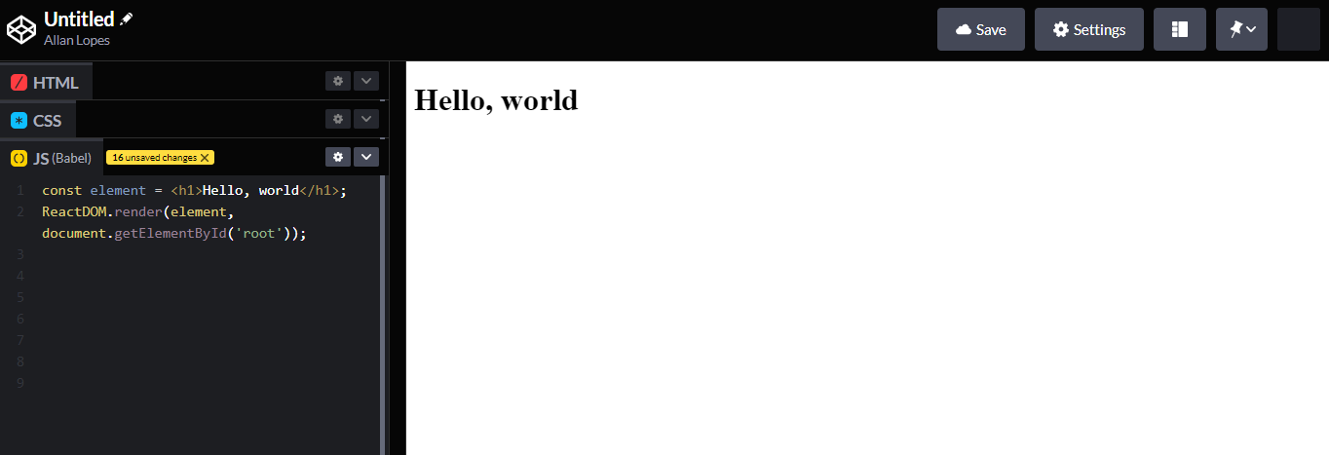

Slide 84
function formatName(user) {
return user.firstName + ' ' + user.lastName;
}
const user = {
firstName: 'pradip',
lastName: 'bind'
};
const element = (
<h1>
Hello, {formatName(user)}!
</h1>
);
const root = ReactDOM.createRoot(document.getElementById('root'));
root.render(<h1>{element}</h1>);

Slide 85
const name = 'Lavanya Vishwakarma';
const element= <h1> Hello, {name} </h1>;
ReactDOM.render(element, document.getElementById('root'));

Slide 86
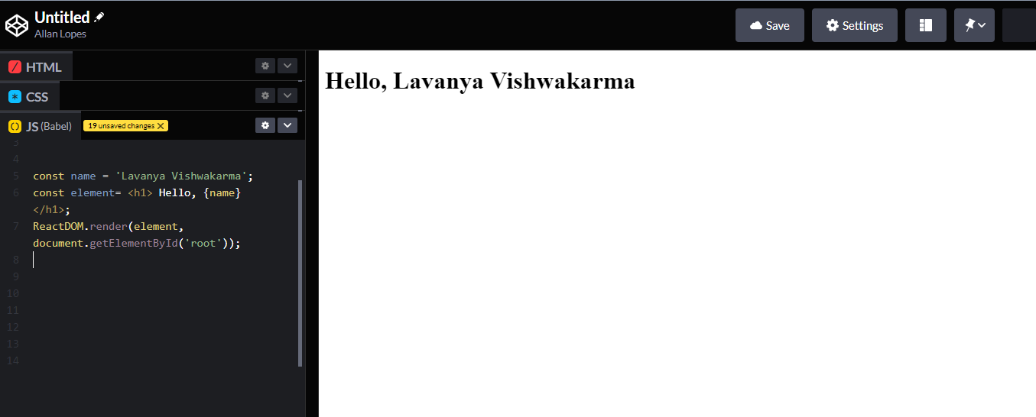

Slide 87
Consider 2nd example where more than one values are passed by reference
In this ex. Variable user which is constant variable having 2 values as firstname and lastname. Another variable element is calling the function formatName() where “user” is passing as a parameter. The values like firstname and lastname can be accessed using “user” name and “.” (period) operator.
ReactDom is going to render these values on page.
After compilation, JSX expressions become regular JavaScript function calls and evaluate to JavaScript objects.
This means that you can use JSX inside of if statements, for loops, assign it to variables, accepts it as arguments, return it from functions.
function formatName(user){
return user.firstName+''+user.lastName;
}
const user ={
firstName:'Saurabh',
lastName:' Shinde'
};
const element= <h1> Hello, {formatName(user)}!</h1>;
ReactDOM.render(element, document.getElementById('root'));

Slide 88
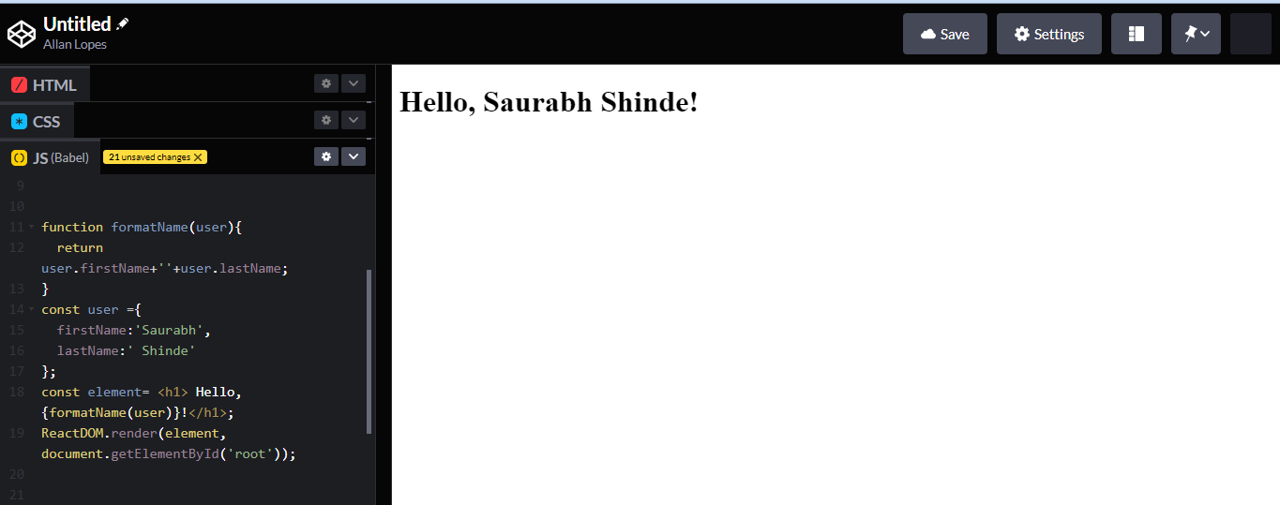

Slide 89
How rendering works in React?
Rendering is the process of React asking your components to describe what they want their section of the UI to look like now, based on the current combination of props and state.
React's default behavior is that when a parent component renders, React will recursively render all child components inside of it!
Loosely coupled
In computing and systems design a loosely coupled system is one. in which components are weakly associated (have breakable relationship) with each other, and so, changes in one component least affect existence or performance of another component.

Slide 90
Nested Element
import React from 'react';
class App extends React.Component{
render(){ return(
<div>
<h1>Header</h1>
<h2>Content</h2>
<p>This is the content!!!</p>
</div>
); }}
export default App;
If more elements is to be returned, then it is needed to wrap with one container element. The following examples shows div as a wrapper for h1, h2 and p elements.

Slide 91
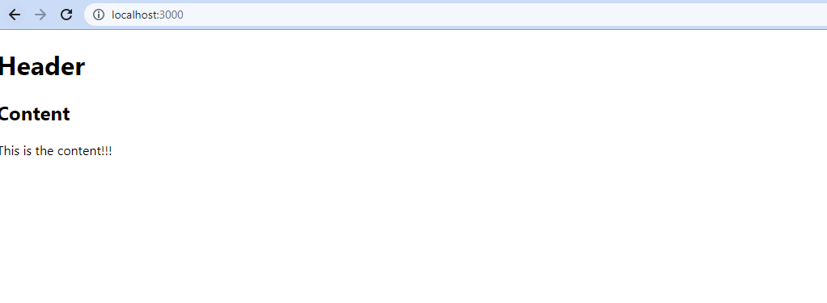

Slide 92
For Jsx tutorial
https://www.tutorialspoint.com/reactjs/reactjs_jsx.htm
https://www.tutorialspoint.com/reactjs/reactjs_components.htm

Slide 93
Custom Attributes
import React from 'react';
class Appe extends React.Component {
render() {
return (
<div>
<h1>Header</h1>
<h2>Content</h2>
<p data-myattribute = "somevalue">Hey sachine.. This is the content!!!</p>
</div>
);
}
}
export default Appe;

Slide 94
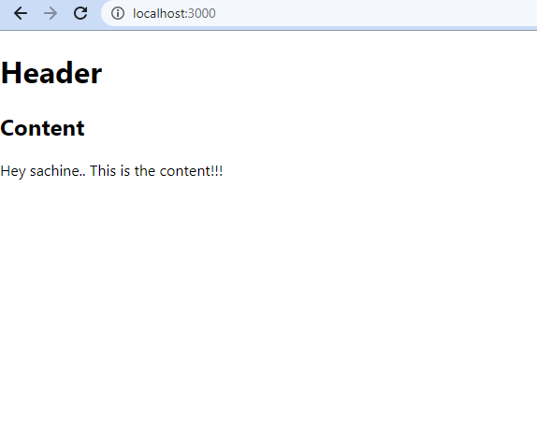

Slide 95
ReactJS Components
Q.2) What are the components of React JS? Explain React components life cycle. May2022 5-Marks
Components are the core building blocks of React applications. They are logical groups of code that make up the entire application. With the use of components, you can build UI’s quickly. Every component works independently, and you can merge them into a parent components.
React components have their unique structure, methods and API’s. Additionally they are also reusable.
There are two ways through which you can create component.
Functional component.
Class component.
Now a days everyone is using functional component so we will learn how to create functional component.

Slide 96
Functional component.
You can only write components using a render method with functional components. These are JavaScript functions that may or may not receive data as parameters. Functional components are also called stateless components since they do not manage the local state.
Ex. of Functional component.
function Welcome(props) {
return <h1>Hello, {props.name}</h1>;
}

Slide 97
Let us now see components as functions. We will create test.jsx file
import React from "react";
import ReactDOM from "react-dom";
function Hello() {
return <h1>Hello, Welcome to ReactJS </h1>;
}
const Hello_comp = <Hello />;
export default Hello_comp;
We have created a function called Hello that returned h1 tag . The name of the function acts as an element,
const Hello_comp = <Hello />;
export default Hello_comp;
The Component Hello is used as an Html tag, i.e. , <Hello /> and assigned to Hello_comp variableand the same is exported using export.

Slide 98
Let us now use this component in index.js file as shown below.
Index.js
import React from "react";
import ReactDOM from "react-dom";
import Hello_comp from "./test.jsx";
ReactDOM.render(
Hello_comp,
document.getElementById('root')
);

Slide 99
2. Class component.
Class components are more complicated than functional components since you have to extend from React. They are also called stateful components since they manage the local state.
You can perform the following with class components.
You can move data from one class to another class component.
You can create a class by defining a class that has a render function.
Ex. of class component.
class MyComponent extends React.Component {
render() {
return <div> This is main component.</div>;
}
}

Slide 100
Let us now see class as component. We will create test.jsx file
import React from "react";
import ReactDOM from "react-dom";
class Hello extends React.Component {
render() {
return <h1> Hello, Welcome to ReactJS!.</h1>;
}}
export default Hello;

Slide 101
Let us now use Hello component in index.js file as shown below.
Index.js
import React from "react";
import ReactDOM from "react-dom";
import Hello from "./test.jsx";
ReactDOM.render(
<Hello />,
document.getElementById('root')
);
//The component Hello is used as an Html tag i.e., <Hello />

Slide 102
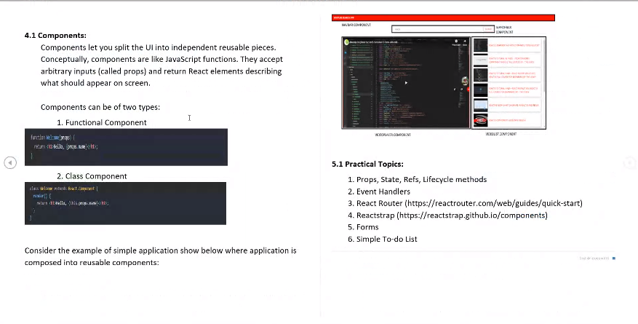

Slide 103
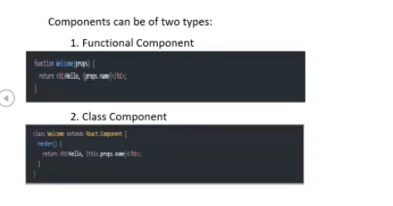
Function function_name() // In function whatever element we want to render that need not to be called through render function, you can directly call that.
{
Html code which we want to render through Browser dom
}
Class class_name()
{
render()// In class whatever element we want to render that need to be called through render function
{
Html code which we want to render through Browser dom
}
}
Along with above difference, there is difference between the way we create class component and function component life cycle is different. There are other things advanced function like hook are added inside functional component and not in class component, we prefer to have Functional component..

Slide 104
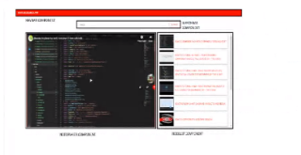
For developing and creating mini projects and to learn life cycle methods we will use functional component. A small application for searching youtube’s video, you can see certain components which helps to do certain task.
For example:- component a will be responsible for returning something. So in this left side image you can see 1st component is simple Navbar component in red color. It will serve something like displaying title of the navbar. Then we have search bar component. Thus search result will responsible for filtering the results which we are getting from API, it will display list of results.
Then we have video list component, so this component will be responsible for displaying all the items we are getting from search.
And finally we have video player component . so whatever video we will clicked should be displayed over here.

Slide 105
So, whenever you create your project in react you should structure your component such a way that it is easily useable across other projects as well as in other files if you want.
Let’s say I have an web application which is not a single page in nature,its having 2-3 pages. Page a, Page B, Page c and in all 3 pages I want to use same component. So instead of keeping it in a single file I will componentize it and I will use the same thing across all 3 files. So, the advantage we get over here is that
We have clindup the code, we don’t have duplicate the code yet in each and every place.
It’s easy to use plug and play like import the component use it where you want. These are the advantage of the component.

Slide 106
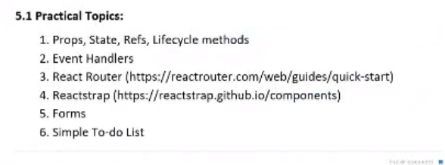
Now, we will see some of the practical topics
Creating simple project using existed library like React Router and Reactstrap,
Reactstrap makes use of class components whereas React-bootstrap makes use of functions and hooks. Both the codes yield similar output and the only difference is the use of the components. The user may choose either depending on their preferences.

Slide 107
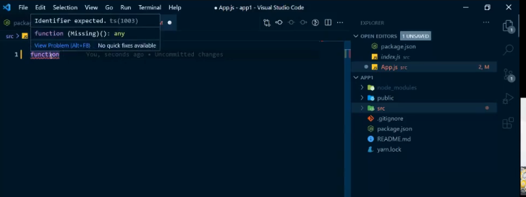
Props:- we will create functional component which will return helloworld
Clean all the content form App.js.
Start writing code, when you will write function it will give error,
Notice you get error over here, this is what the significance of eslint which is configured in package.json , just to give errors if there are any..
"eslintConfig": {
"extends": [
"react-app",
"react-app/jest"
]
},

Slide 108
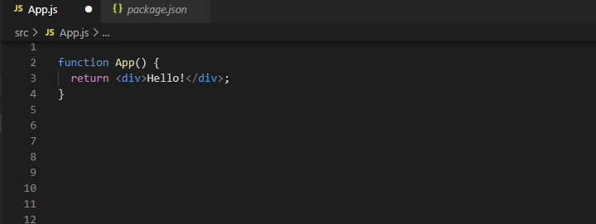
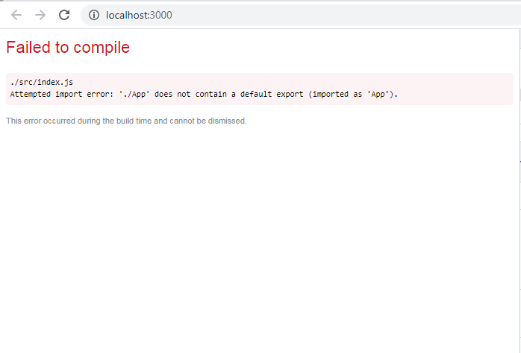
Now whatever code I have written w.r.to that I must get output but it’s showing error, So other thing to keep in mind is whenever you create component whether it’s function or class at the end of file you should export this component., so that it can be used in other files. Since we are already used App component in index.js so here we are trying to run w/o exporting it...that’s the reason we are getting error. So it’s mandatory to export each and every component if is used in some other file. Here App.js is been consumed by other file index.js in 3rd line import App from './App';
So I have to make sure index.js must get this file.

Slide 109
Copy below code and see the browser App.js
function App() {
return <div>Hello!</div>;
}
export default App;

Slide 110
index.js
import React from "react";
import ReactDOM from "react-dom";
import App from './App';
// import ParentComponent from "./propsDemo/ParentComponent";
// import Counter from "./stateDemo/Counter";
// import CounterUsingRef from "./refsDemo/CounterUsingRef";
// import UseEffectDemo from "./useEffectDemo/UseEffectDemo";
//import FetchData from "./useEffectDemo/FetchData";
import reportWebVitals from "./reportWebVitals";
ReactDOM.render(
<React.StrictMode>
<App />
</React.StrictMode>,
document.getElementById("root")
);
// If you want to start measuring performance in your app, pass a function
// to log results (for example: reportWebVitals(console.log))
// or send to an analytics endpoint. Learn more: https://bit.ly/CRA-vitals
reportWebVitals();

Slide 111


This is very basic component which we have created over here.

Slide 112


Slide 113

Press ctrl + s after this code

Slide 114


Slide 116

Next remove the index.css and App.css file it is not necessary, also we will remove from where this things will be from index.js remove 3rd line then save it and reload the browser we will get same Hello!. We have removed unnecessary part of the code.

Slide 117
Why we should remove unnecessary files?
As it slow down the server and unnecessary files may create load on server. Our current project is in .2 or 1 kb..but in big project when it will be in MB it will be difficult to manage. Unnecessary files are getting loaded if it’s not removed. This may impact web performance. It may increase the load time.

Slide 118
ReactJS State
React components has a built-in state object.
The state object is where you store property values that belongs to the component.
When the state object changes, the component re-renders.
https://www.w3schools.com/react/react_state.asp
.

Slide 119


Slide 120


Slide 121


Slide 122

https://www.w3schools.com/react/showreact.asp?filename=demo2_react_state

Slide 123


Slide 124


Slide 125
To see demonstration
https://www.w3schools.com/react/showreact.asp?filename=demo2_react_state_setstate

Slide 126
State management is one of the important and unavoidable features of any dynamic application. React provides a simple and flexible API to support state management in a React component. Let us understand how to maintain state in React application in this chapter.
What is state?
State represents the value of a dynamic properties of a React component at a given instance. React provides a dynamic data store for each component. The internal data represents the state of a React component and can be accessed using this.state member variable of the component. Whenever the state of the component is changed, the component will re-render itself by calling the render() method along with the new state.
A simple example to better understand the state management is to analyse a real-time clock component. The clock component primary job is to show the date and time of a location at the given instance. As the current time will change every second, the clock component should maintain the current date and time in it’s state. As the state of the clock component changes every second, the clock’s render() method will be called every second and the render() method show the current time using it’s current state.
The simple representation of the state is as follows −
{
date: '2020-10-10 10:10:10'
}

Slide 127
ReactJS State
In ReactJS, the State contains information about the components and can change over time. It can either be a response to user action or a system event. Data collected in a state is a private object.
Components within the state are called stateful components.
They regulate the component’s behavior and make it more interactive.
You can access or modify the state only inside the component or directly by the component. You should always simplify your state as much as possible and reduce the number of stateful components.
For example :- if you have 10 components requiring data from the state, you should create a single container component that will keep the state for all the components.
.

Slide 128
Ex. of state on how to use state inside a class test.jsx
test.jsx
import React from "react";
import ReactDOM from "react-dom";
class Hello extends React.Component {
constructor(props){
super(props);
this.state= {
msg:”Hello, Welcome to ReactJS!”
}
}
render() {
return <h1> {this.state.msg} </h1>;
}}
export default Hello;

Slide 129
Index.js
import React from "react";
import ReactDOM from "react-dom";
import Hello from "./test.jsx";
ReactDOM.render(
<Hello />,
document.getElementById('root')
);

Slide 130
Try it on CodePen
https://codepen.io/gaearon/pen/KgQpJd?editors=0010
State and Lifecycle
https://reactjs.org/docs/state-and-lifecycle.html
What Is ‘State’ in ReactJS?The setState() MethodState vs. Props- must visit
https://www.simplilearn.com/tutorials/reactjs-tutorial/reactjs-state

Slide 131

ReactJS Props
https://www.w3schools.com/REACT/react_props.asp

Slide 132


Slide 133

https://www.w3schools.com/REACT/showreact.asp?filename=demo2_react_props

Slide 134
Props are nothing but properties you can use inside a component. They are read-only variables that store the value of attributes of a tag.
Props are similar to function arguments because you can pass them to the components in a similar way as arguments.

Slide 135
Ex. of passing Props to a function component
Test.jsx
import React from "react";
import ReactDOM from "react-dom";
function Hello(props){
return <h1>{props.msg}</h1>;
}
Const Hello_comp= <Hello msg =”Hello, Welcome to ReactJS!” />;
export default Hello_comp;
As shown above, we have added msg attribute to <Hello /> component. The same can be accessed as props inside Hello function, which is an object that will have the msg attribute details, and the same is used as an expression.

Slide 136
The component is used in index.js as follows:
index.js
import React from "react";
import ReactDOM from "react-dom";
import Hello_comp from "./test.jsx";
ReactDOM.render(
Hello_comp,
document.getElementById('root')
);

Slide 137
Ex. to access the Props in a class component
Test.jsx
import React from "react";
import ReactDOM from "react-dom";
Class Hello extends React.Component {
render() {
return <h1>{this.props.msg}</h1>;
}
}
export default Hello;
As shown above, we have added msg attribute to <Hello /> component. The same can be accessed as props inside Hello function, which is an object that will have the msg attribute details, and the same is used as an expression.

Slide 138
The msg attribute is passed to the component in index.js as follows:
index.js
import React from "react";
import ReactDOM from "react-dom";
import Hello from "./test.jsx";
ReactDOM.render(
<Hello msg= “Hello, Welcome to ReactJS!” />,
document.getElementById('root')
);

Slide 139
State and Props in React
Props are nothing but something which you pass to a function, so if I take a basic example of a project let’s say if I am writing something in javascript, and I have each and every function which is responsible for doing something. And each and every function accepts some parameter. For example:-
If I have fun A() in App.js and function B() and I want to pass something from B to A. and like I want to pass 5 to A. So here we are trying to pass one value to the other function. This is parameter passing to the function and that is what props actually are.
fun A(v){
}
Function B(){
a=5;
A(5); //
}

Slide 140
I have multiple components lets say A & B and this component B is present inside component A. and I have something which is present inside A like value 5(which is present inside A) then how will component B will have access to this value., that’s where a props comes into the picture. Let’s say I want to have a some value in B which is also present in A, then I will use props for it.
A -> B
Now we will Create one folder inside src and give name as propsDemo (we have created one directory over here and inside that directory we will create one component i.e. parent component ParentComponent.js and also another child component as ChildComponent.js.) create two files inside that folder as ParentComponent.js and ChildComponent.js.
Right now we don’t have anything over here we will try to mimic the behaviour like of App.js over here. I have to make sure that whatever value present inside ParentComponent are also available to the ChildComponent, so we will use props over here.
1st we need to create basic template of the component and export it, so that some other files can use it, so we will just create that over here,
We will create parent component which just return nothing initially, simillarly we will create ChildComponent,and will execute but it just return Hello only. I said earlier thet how can you render the component which you want when Apps gets loaded, So, to do that we can do changes in index.js, and instead of //import App from './App'; we will write import ParentComponent from "./propsDemo/ParentComponent";, also in ReactDOM.render() Method we will write <ParentComponent /> instead of <App />.
I.e. instead of importing all the component from App.js we want to render component from ParentComponent.js when my apps gets loaded. ./ represent the current directory.

Slide 141


Slide 142
https://snipper.io/s/-McIYXR6cEvW-VVXUeKE

Slide 143
ParentComponent.js
function ParentComponent() {
return (
<div><p>Hello for parent component</p>
</div>
);
}
export default ParentComponent;

Slide 144
ChildComponent.js
function ChildComponent() {
return;
}
export default ChildComponent;

Slide 145
index.js
import React from 'react';
import ReactDOM from 'react-dom';
//import App from './App';
import ParentComponent from "./propsDemo/ParentComponent";
import reportWebVitals from './reportWebVitals';
ReactDOM.render(
<React.StrictMode>
<ParentComponent />
</React.StrictMode>,
document.getElementById('root')
);
// If you want to start measuring performance in your app, pass a function
// to log results (for example: reportWebVitals(console.log))
// or send to an analytics endpoint. Learn more: https://bit.ly/CRA-vitals
reportWebVitals();

Slide 146

Output window
This is how you render your component when apps gets loaded, now we will see the props.

Slide 147
ParentComponent.js
Now understand the Props
let a = "Prop from parent component";
/* a Variable declaration having simple string and
we want to make sure that this string is been displayed from my childComponent, so for that purpose we first need to import ChildComponent from same directory
i.e. import ChildComponent from "./ChildComponent";
Now there is no need to pass anything like <p>Hello for parent component</p>,
we simply pass <ChildComponent />, and further how can you pass a prop , so we can pass it using this
thing <ChildComponent a2={a} />, we have defined a key and value pair over here as a2={a} , so this is the
value which we want to pass inside child component and How can we access this value?
so we can access this value using a2. */
import ChildComponent from "./ChildComponent";
function ParentComponent() {
let a = "Prop from parent component";
return (
<div>
<ChildComponent a2={a} />
<p>Hello from parent component</p>
</div>
);
}
export default ParentComponent;

Slide 148
ChildComponent.js
function ChildComponent(props) {
const { a2 } = props;
return <div>{a2}</div>;
}
export default ChildComponent;

Slide 149
index.js
import React from 'react';
import ReactDOM from 'react-dom';
//import App from './App';
import ParentComponent from "./propsDemo/ParentComponent";
import reportWebVitals from './reportWebVitals';
ReactDOM.render(
<React.StrictMode>
<ParentComponent />
</React.StrictMode>,
document.getElementById('root')
);
// If you want to start measuring performance in your app, pass a function
// to log results (for example: reportWebVitals(console.log))
// or send to an analytics endpoint. Learn more: https://bit.ly/CRA-vitals
reportWebVitals();

Slide 150

Prop from parent component
Hello from parent component

Slide 151

Since we are passing props to the child function, so this function accepts props in ChildComponent.
Here ParentComponent not accepting any props, but we want child component to accept props, which is being passed from this ParentComponent

Slide 152


Slide 153
Output Browser
This is how we use props in nature. In short, if we have some value which is present inside parent component and we also want that value to be accessible in child component then we use props in react.
By simply importing the component where you want to pass it, so in this case we imported ChildComponent, also we just used the tag (<ChildComponent a2={a} />) over here passed it in the form of key value pair, where a is passed as a. In child component accepts this props and we are just trying to restructure it, just trying to get a from props, and displaying that a in ChildComponent.

Slide 154

Imp.Note:-
whenever you create component in react it should be always wrap inside a single parent tag.
For ex.:-if you write <p> hello</p> in ParentComponent then it will give below error so to resolve that we are using <Div> tag as parent tag
JSX expression must have one parent element.

Slide 155
In output we are getting whatever we are trying to return from child component and 2nd thing is Hello from parent component. First thing we are rendering from child Component and 2nd thing thing we are rendering from parent Component.
This is how props work.
Props are nothing but a parameter which we are passing into some other component. Ex:- Basic example is how functions are created. If I have one function called as A and those function accepts some parameter some values which might responsible for doing some stuff, so props are similar to what function accepts, so function accepts parameter, In react we called it as Props, because we are passing it to some other component, props is similar to a parameter which we are passing to a function.

Slide 156


Slide 157
Prop from parent component
Hello from parent component

Slide 158

If you want to add one more tag inside <div> then we have two methods
Create another component like parentComponent or ChildComponent export it from that file and import it in ChildComponent file or 2) simply add below function in ChildComponent.

Slide 159

It will give 3 lines in output.

Slide 160
Error:
My development server started but it’s giving error in localhost://3000 module not found can not resolved vitals in ...path
Ans:- 1st close development server and try running one command in terminal of vs code npm install and once this command done then try running development server by using yarn start or npm start.
Also we can’t put multiple components inside ReactDOM.render() function of index.js file. Since it is a starting point of our application, If we want then we can add inside parent or child component but not allowed in index.js. It will be allowed only inside the <div>tag.

Slide 161
Now we will create another directory inside src as StateDemo inside this we will create another file Counter.js,
Here we will be creating simple counter using the states, Here again we will follow the similar approach that we did previously for creating component, you will have to create simple function and export that function from the application and just to maintain the consistency the name of the function and name of the file will be similar.
If you want default template to be created, then we will use available extensions

Slide 162

Add this extension
ES7 React/Redux/GraphQL/React-Native snippets

Slide 163


Slide 164

For default Template use above keyword
Refer this for more Snippets:- https://marketplace.visualstudio.com/items?itemName=xabikos.ReactSnippets

Slide 165


Slide 166


Slide 167
https://jsonplaceholder.typicode.com/

Slide 168
State is nothing but you have an simple single page web application, where you are making some API calls to the server, and you are getting data back, and let’s say you have couple of buttons available on your web application like search or something like that. Now when you try to click on search you have to call your backend server and try to fetch the results, But how can we do it? How can you see new data on your website When there is dynamic changing data? So that’s where states come into picture.
What you can do? you can create a states where you can store your default data and whatever data present inside that states you can use it to display items on your browser and whenever some user performs some action like clicks on buttons you will make a call to that server, get the new data and update your states so that new data is seen on your Browser DOM. so really happens that whenever a states change takes place, your browser dom gets rerun with the new thing and that’s where virtual dom comes into the picture. So it just try to find what’s new differentiate what’s new change and what’s not change. And depending upon the manipulation it updates the Browser Dom.

Slide 169
Counter.css
.counter-container {
display: flex;
justify-content: center;
align-items: center;
width: 100%;
height: 60vh;
}
/*Two ways through which you can give style to button -
1) By using that element 2)By using that element class */
/* button {
margin: 10px;
} */
.action-buttons {
margin: 10px;
}

Slide 170
Let’s try to understand this with simple counter example.
Counter.js
import React, { useState } from "react"; //we have imported usestate from React itself
//import "./Counter.css";
function Counter() {
const [counter, setCounter] = useState(0);//This is how you declare a state in React
// Here counter signifies the recent value of the state, recent value is 0,
//so when you try to show cunter on your sceen you will see nothing but 0.
//setCounter reponsible for updating the pervious state, which we were having
// so whenever you call this function and we pass any new value that value will get available in this (counter) counter variable.
//
let incrementCounter = () => {
setCounter(counter + 1);
};
let decrementCounter = () => {
setCounter(counter - 1);
};
return (
<div className={"counter-container"}>
<button className={"action-buttons"} onClick={incrementCounter}>
Increment (+)
</button>
{counter}
<button className={"action-buttons"} onClick={decrementCounter}>
Decrement (-)
</button>
</div>
);//Here we will have two buttons increment and decrement available and
//between this 2 button we will display the value of the counter,
// whenever this buttons are triggered that time whatever values availble in the counter should be displayed over here.
}
export default Counter;

Slide 171
index.js
import React from "react";
import ReactDOM from "react-dom";
// import App from './App';
// import ParentComponent from "./propsDemo/ParentComponent";
import Counter from "./stateDemo/Counter";
import reportWebVitals from "./reportWebVitals";
ReactDOM.render(
<React.StrictMode>
<Counter />
</React.StrictMode>,
document.getElementById("root")
);
// If you want to start measuring performance in your app, pass a function
// to log results (for example: reportWebVitals(console.log))
// or send to an analytics endpoint. Learn more: https://bit.ly/CRA-vitals
reportWebVitals();

Slide 172


Slide 173

In output window we are getting initial value as 0 because we have assigned initial value as 0.

Slide 174
Let’s add some styling to it i.e css file:- Counter.css
.counter-container {
display: flex;
justify-content: center;
align-items: center;
width: 100%;
height: 60vh;
}
/*Two ways through which you can give style to button -
1) By using that element 2)By using that element class */
/* button {
margin: 10px;
} */
.action-buttons {
margin: 10px;
}

Slide 175
Based on our action(onClick={incrementCounter}) or onClick={decrementCounter}
certain action will be performed.

Slide 176
This is how states are used when we have any dynamic change in data on our website, so we used state. Initial value can be anything but whenever we get any new data, it just update the state and this component gets rerendered, so whatever changes are present in that state will be reflected over output window.
If you get any error in our console While debugging so how to debugge it?
Go to inspect and go to source, open Counter.js and add points to certain lines to add debugger.

Slide 177

Debugging points

Slide 178

If you want your counter should not decrement to -1 then simply add below condition in decrementCounter function()

Slide 179

To get parent component in output simply add

Slide 180


Slide 181
To comment some part of your code simply press ctrl + /

Slide 182

When the same file getting updated from different location or component that time you may get different value so to avoid that use prev variable with arrow function.

Slide 183
What does Prev mean in React?
What it holds is the value of state before the setState was triggered by React; Since setState does batching, its sometimes important to know what the previous state was when you want to update the new state based on the previous state value.
How do I get the previous value in React?
With React class components you have the componentDidUpdate method which receives previous props and state as arguments or you can update an instance variable (this. previous = value) and reference it later to get the previous value.

Slide 184

To display value in decrement counter only when it is greater then 0.

Slide 185
ReactJS - Component Life Cycle
Q.3) Explain React components life cycle. May2022 5 marks
Or What are the different life cycle methods in React?
There are 4 phases in components life cycle. They are :
Initial phase
Mounting phase
Updating phase
Unmounting phase

Slide 186
Initial phase :
This phase is Considered the birth phase in a ReactJS components life cycle. In this, the component begins its way to the DOM. During this phase, the component includes both default Props and the initial State.
The initial phase includes the following methods:
getDefaultProps(): - It defines the default value of this.props.
getInitialState():- It defines the default value of this.state.

Slide 187
2. Mounting phase
In this mounting phase, you create the component instance and insert it into the DOM.
It has following methods:
componentWillMount() :- You Call this method before the rendering of a component into the DOM. The component will not re-render when you call setState() in this method.
componentDidMount() :- You Call this method after rendering a component and placing it on the DOM. Then, you can perform DOM querying operations.
Render():- You define this method in every component. You cannot return a single root HTML node element. However, You can return a null or false value if you don't want to render anything.

Slide 188
3. Updating phase
In this phase, you can handle the user interaction and communication with the hierarchy of components. In this phase, the priority is to make sure that the component’s latest version is displayed. Unlike the previous stages, the updating phase repeats over and over again.
It includes the following methods:-
componentWillReceiveProps():- You call this method when a component receives a new prop.
shouldComponentUpdate():- You call this method when a component decides it wants to make changes to the DOM. You can control the component’s behaviour when it gets updated.
componentWillUpdate():- You Call this method before the component update. You cannot use the this.setState() method to change the component state. Further, if shouldComponentUpdate() returns false, then this method will not be called.
render() :- you call this to inspect this.props and this.state.
It returns any of the following: Arrays and fragments, String and Number, Booleans or null react elements.
componentDidUpdate():- You Immediately call this method when the component is updated.

Slide 189
4. Unmounting phase
The unmounting phase is the last phase of the React component lifecycle. It is invoked in a situation when a component instance is unmounted and destroyed from the the DOM.
Iit contains only one method as given below:
componentWillUnmount() :-
You Call this method before a component is unmounted and eliminated permanently.
This method performs cleanup task like, event listening, cancelling network request, invalidating timers, cleaning up DOM elements etc.

Slide 190
React Lifecycle of Components
https://www.w3schools.com/REACT/react_lifecycle.asp
https://www.tutorialspoint.com/reactjs/reactjs_component_life_cycle.htm

Slide 191
complife.jsx
import React from "react";
import ReactDOM from "react-dom";
class COMP_LIFE extends React.Component {
constructor(props) {
super(props);
this.state = {name:" "};
this.UpdateName = this.UpdateName.bind(this);
this.testclick = this.testclick.bind(this);
}
UpdateName(event)
{
this.setState({name:event.target.value});
}
testclick(event)
{
alert("The name entered is: " + this.state.name);
}
componentDidMount() {
console.log('Mounting State : calling method componentDidMount');
}
shouldComponentUpdate(){
console.log('Update state : calling method shouldComponentUpdate');
return true;
}
componentDidUpdate(){
console.log('Update state : calling method componentDidUpdate');
}
componentWillUnmount() {
console.log('Unmounting State : calling method componentWillUnmount');
}
render() {
return (
<div>
Enter your name:<input type="text" value= {this.state.name} onChange= {this.UpdateName} /> <br />
<h2>{this.state.name}</h2>
<input type="button" value= "Click Here" onClick= {this.testclick} />
</div>
);
}
}
export default COMP_LIFE;

Slide 192
index.js
//React Lifecycle of Components
import React from "react";
import ReactDOM from "react-dom";
import COMP_LIFE from "./complife.jsx";
ReactDOM.render(
<COMP_LIFE />,
document.getElementById('root')
);

Slide 193

When you check the output in the browser

Slide 194

After entering some strings it will show like this

Slide 195

After deleting some characters from entered string it will show like this

Slide 197
ReactJS Router
Q.5) Create a single page application in React using React-Router.
When a user is directed to a page based on their action or request, the process is called routing. The primary function of a ReactJS router is to develop Single page Web Applications.
Foe ex. When a user type a URI in their browser, they will be redirected to a route that matches the URL path. In React, routing is created using the React Router package.
The most important reason why you need a React router is to show multiple views in single-page applications. Several popular social media websites like Instagram, for example use React Router to display multiple views.
React Router is one of the most popular routing frameworks for React. The library is designed with intuitive components to let you build a declarative routing system for your application. This means that you can declare exactly which of your components has a certain route. With declarative routing, you can create intuitive routes that are human-readable, making it easier to manage your application architecture.

Slide 198
Components in React Router
BrowserRouter:- This component handles the dynamic URL.
HashRouter:- This component handles the static request
Set up routing for an app
Step 1: Install a React Router
To install the react-router command is used.
npm install react-router
Step 2:- Create Components
In this step, we will create four components. The App component will be used as a tab menu. The other three components (Home) , (About) and (Contact) are rendered once the route has changed .
.

Slide 199
Refer both examples below
https://www.w3schools.com/react/react_router.asp
https://v5.reactrouter.com/web/example/basic

Slide 200
main.js
import React from "react";
import ReactDOM from "react-dom";
import { Router, Route, Link, browserHistory, IndexRoute } from "react-router";
class App extends React.Component {
render() {
return (
<div>
<ul>
<li>Home</li>
<li>About</li>
<li>Contact</li>
</ul>
{this.props.children}
</div>
)
}
}
export default App;
class Home extends React.Component {
render() {
return (
<div>
<h1>Home</h1>
</div>
)
}
}
export default Home;
class About extends React.Component {
render() {
return (
<div>
<h1>About...</h1>
</div>
)
}
}
export default About;
class Contact extends React.Component {
render() {
return (
<div>
<h1>Contact...</h1>
</div>
)
}
}
export default Contact;
ReactDOM.render((
<Router history ={browserHistory}>
<Route path = "/" component ={App}>
<IndexRoute component = {Home} />
<Route path="home" component={Home} />
<Route path="about" component={About} />
<Route path="contact" component={Contact} />
</Route>
</Router>
), document.getElementById("app"))

Slide 201
React Router-DOM and Single page applications
Open app1 project in VS code from command prompt.
For official document of react router dom, simply search react router dom in google or open below link:- https://reactrouter.com/web/guides/quick-start
What this library is responsible for?
React Router is a standard library for routing in React. It enables the navigation among views of various components in a React Application, allows changing the browser URL, and keeps the UI in sync with the URL. ... The application will contain three components: home component, about a component, and contact component. This library is responsible for routing between different pages in your application, For ex:- where we have Home page, About page and where we have contact information etc. So how can you route between this pages? So in react we have something called as react-router-dom to achieve it. Kindly ref. this site https://reactrouter.com/web/guides/quick-start
Now we will discuss the Installation part and 1st Example: Basic Routing
We have code available here in this site, now open package.json,

Slide 202

As specified earlier, whatever modules and libraries which you have installed for this package will be listed in this dependencies, right now we do not have react-router-dom present over here, so how can I installed it?

Slide 203
Go to the VS code terminal, as you might have created project using yarn or npx.
For people who have created using yarn they can install this library using
yarn add react-router-dom
For people who have created using npx they can install this library using
npm install react-router-dom
This will start installing package for me.

Slide 204


Slide 205

This will start installing package for me.

Slide 206


Slide 207

You manually no need to add anything inside package.json, now we can see package along with it’s version.Latest version is 5.2.0.
People having 16 GB RAM,it will work fast.

Slide 208
"react-router-dom": "^5.2.0", whenever this ^ circumflex symbol present and whenever you try to install anything, this will try to find latest version available for that package.
For ex:- After one month if I give this project to someone else, they don’t have libraries installed with them, so they will have to installed this library into their system, so when they install the library into their system after one month is possible that he new version of this package is listed, it might be like 5.2.x, so this ^ symbol check the new version with existed one and compare it. If we don’t want to install the latest version or If we want to give project to someone else with same version then simply remove ^ circumflex symbol.

Slide 209

Now we will create new folder inside src as reactRouterDemo having a file as RouterDemo.js,
https://snipper.io/s/-McXW1gQlvgfbWrPqAKB

Slide 210

UI Design (libraries) - reactstrap Add below extension in VS code for snippets Reactjs code snippets

Slide 211

import React from "react";
function RouterDemo() {
return (
<div> React Router </div>
);
}
export default RouterDemo;

Slide 212
What is difference between react router and react router dom?
They are technically three different packages: React Router, React Router DOM, and React Router Native. The primary difference between them lies in their usage. React Router DOM is for web applications and React Router Native is for mobile applications made with React Native.

Slide 213
"dependencies": {
"@testing-library/jest-dom": "^5.11.4",
"@testing-library/react": "^11.1.0",
"@testing-library/user-event": "^12.1.10",
"react": "^17.0.2",
"react-dom": "^17.0.2",
"react-router-dom": "^5.2.0",
"react-scripts": "4.0.3",
"reactstrap": "^8.9.0",
"web-vitals": "^1.0.1"
},

Slide 214
https://reactrouter.com/web/guides/quick-start
1st Example: Basic Routing
They have 3 pages over here home, about and users page. We should able to navigate through this pages, Whenever someone clicks on that button, or someone clicks on that links. So how can we achieve that, The way they have imported it, we will follow the same approach,

Slide 215
Here the domain route is localhost://3000, we are running our project on localhost://3000
If you observe the link then we have specified in link something called as to is nothing but your home page. So whatever component you want to render specified by /.
You can see here the home is in different color, when I clicked on about my URL getting change to about, but at the bottom we haven’t seen anything because we have not written anything about page. Sill when I clicked on user you should navigate to user page that’s what we have specified in link. So whenever someone clicks on the link you should navigate to specific page. For home we are navigating to main domain url i.e. localhost://3000.

Slide 216
index.js
import React from "react";
import ReactDOM from "react-dom";
// import App from './App';
// import ParentComponent from "./propsDemo/ParentComponent";
// import Counter from "./stateDemo/Counter";
// import CounterUsingRef from "./refsDemo/CounterUsingRef";
// import UseEffectDemo from "./useEffectDemo/UseEffectDemo";
//import FetchData from "./useEffectDemo/FetchData";
//import RouterDemo from "./reactRouterDemo/RouterDemo";
import RouterDemo from "./reactRouterDemo/RouterDemo";
import reportWebVitals from "./reportWebVitals";
ReactDOM.render(
<React.StrictMode>
<RouterDemo />
</React.StrictMode>,
document.getElementById("root")
);
// If you want to start measuring performance in your app, pass a function
// to log results (for example: reportWebVitals(console.log))
// or send to an analytics endpoint. Learn more: https://bit.ly/CRA-vitals
reportWebVitals();

Slide 217
RouterDemo.js
import React from "react";
import { BrowserRouter as Router, Switch, Route, Link } from "react-router-dom";
//(BrowserRouter as Router) this library responsible for routing you through this pages, like this component
//Switch:- helps you to navigate you to different pages
//Route :- inside this we need to specify which component we want to render when someone is visiting any specific page
//Link:- It just specifies the link to where you want to navigate
//So above is the stuff which we need to render from react-router-dom
import Home from "./Home";
import About from "./About";
import User from "./User";
import PageNotFound from "./PageNotFound";
function RouterDemo() {
return (//Now instead of returning div we have some higher order components already present,
//whenever you are creating any application, you need to wrap your entire application inside <Router>
//router so we will be creating router over here <Router>, we can directly use BrowserRouter over here
//instead of <Router> but just for easy namesake and to shorthand purpose we are using <Router>
//that's the reason BrowserRouter as Router written in import.
//Nav represents navbar which we are observing at the top of screen that navigating to different pages
//Since we are returning single jsx element, so we need to wrap it into <div> tag.
// Next we have HTML unordered list having list item available
//Link to:- is used to specify the link to the page,also it specifies where we want to navigate
<Router>
<div>
<nav>
<ul>
<li>
<Link to="/">Home</Link>
</li>
<li>
<Link to="/about">About</Link>
</li>
<li>
<Link to="/user">User</Link>
</li>
</ul>
</nav>
<Switch>
<Route path="/" exact component={Home} />
<Route path="/about" exact component={About} />
<Route path="/user" exact component={User} />
<Route component={PageNotFound} />
</Switch>
</div>
</Router>
);
}
export default RouterDemo;

Slide 218
PageNotFound.js
import React from "react";
import { Link } from "react-router-dom";
function PageNotFound() {
return (
<div>
We cannot find a page you were looking for.
<Link to="/">Try the Homepage.</Link>
</div>
);
}
export default PageNotFound;

Slide 219
Home.js
import React from "react";
function Home() {
return <div>Welcome to Home Page!</div>;
}
export default Home;

Slide 220
About.js
import React from "react";
function About() {
return <div>Welcome to About Page!</div>;
}
export default About;

Slide 221
User.js
import React from "react";
function User() {
return <div>Welcome to User Page!</div>;
}
export default User;

Slide 222


Slide 223


Slide 224


Slide 225
So it’s easy for user to navigate on different pages,
<Route path="/user" exact component={User} />
It match the exact path which we have specified over there. This is called as single page application, even though we have multiple pages, still it’s called single page application. Why?
The reason behind this is that if you look at the title over here, when I try to navigate any of this pages, my page is not getting reloaded, If it’s single page application and if you try to navigate then you should see the loading icon at the top beside title, but here it’s not seeing that when I am trying to navigate different pages it’s not loading that for rendering component, that’s the reason it’s called single page application, even through we have multiple pages application.

Slide 226

Change the url to some diff. name and you will get message as
We cannot find a page you were looking for.Try the Homepage.

Slide 227

Go to https://www.flipkart.com, https://www.flipkart.com/34545
The same thing which we have done over her, their UI is different.

Slide 229
ReactJS Forms
In reactJS html input elements like <input />, <textarea />, and <select /> has their own state and needs to be updated when user interacts using the setState() method.

Slide 230
form.jsx
import React from "react";
import ReactDOM from "react-dom";
class Form extends React.Component {
constructor(props) {
super(props);
this.state = {name:" "};
this.UpdateName = this.UpdateName.bind(this);
this.formSubmit = this.formSubmit.bind(this);
}
UpdateName(event)
{
this.setState({name:event.target.value});
}
formSubmit(event)
{
alert("The name entered is: " + this.state.name);
}
render() {
return (
<form>
Enter your name:<input type="text" value= {this.state.name} onChange= {this.UpdateName} /> <br />
<h2>{this.state.name}</h2>
<input type="submit" value= "Submit" onClick= {this.formSubmit} />
</form>
);
}
}
export default Form;

Slide 231
For the input fields, we need to maintain the state, so for that react provides a special method called setState, which helps to maintain the state whenever there is a change.
We have used events onChange and onClick on the textbox and submit button. When the user enters inside the textbox the onChange event is called, and the name field inside state object state is updated as shown below:
UpdateName(event)
{
this.setState({name:event.target.value});
}

Slide 232
index.js
//For another React Form
import React from "react";
import ReactDOM from "react-dom";
// import App from './App';
// import ParentComponent from "./propsDemo/ParentComponent";
// import Counter from "./stateDemo/Counter";
// import CounterUsingRef from "./refsDemo/CounterUsingRef";
// import UseEffectDemo from "./useEffectDemo/UseEffectDemo";
import Form from "./form.jsx";
import reportWebVitals from "./reportWebVitals";
ReactDOM.render(
<React.StrictMode>
<Form />
</React.StrictMode>,
document.getElementById("root")
);
// If you want to start measuring performance in your app, pass a function
// to log results (for example: reportWebVitals(console.log))
// or send to an analytics endpoint. Learn more: https://bit.ly/CRA-vitals
reportWebVitals();

Slide 233


Slide 234
UI Design (libraries) - reactstrap Add below extension in VS code for snippets Reactjs code snippets

Slide 235
https://marketplace.visualstudio.com/items?itemName=xabikos.ReactSnippets
Reactjs code snippets shortcuts:
rcc
Sst - for setState method

Slide 236
UI libraries - reactstrap(As per the syllabus)
Couple of libraries available in the market, we will see reactstrap library which is similar to Bootstrap
Search in google :-
1) react bootstrap:- https://react-bootstrap.github.io/
2) reactstrap:- https://reactstrap.github.io/
3) Library Material ui react:- https://material-ui.com/
https://reactstrap.github.io/
https://snipper.io/s/-McXW1gQlvgfbWrPqAKB

Slide 237

If you go to the component then so many components are available.

Slide 238

3) Library Material ui react:- https://material-ui.com/
Developed by google

Slide 239
reactstrap:- https://reactstrap.github.io/
Command to add reactstrap:-
yarn add reactstrap
npm install reactstrap
npm install reactstrap,
We don’t required to add react react-dom as it is already installed.
^CTerminate batch job (Y/N) press ctrl + c to Terminate batch job
Write Cls to clear screen

Slide 240



Slide 241
https://reactstrap.github.io/components/form/
In above link you can see the form components having ready made code available, but we don’t have states in code we will use states here in this.
Also we will learn how can we use states with existed UI library over here.
Now create one directory inside src as reactStrapDemo, and create one file FormDemo.js, here we will create a form with couple of things like email-id, password with submit and cancel button, so on submit any of the field is empty then we will show alert or else we will have cancel button which will clear or reset everything.

Slide 242
https://reactstrap.github.io/components/spinners/
https://reactstrap.github.io/components/pagination/#
If you have multiple pages in your application then you can use pagination, instead of react-router, then table, navbar available.

Slide 243
Go to the form,
Adding Bootstrap
Install reactstrap and Bootstrap from NPM. Reactstrap does not include Bootstrap CSS so this needs to be installed as well:
npm install --save bootstrap
npm install --save reactstrap react react-dom
command to install bootstrap
npm install bootstrap
yarn add bootstrap

Slide 244


Slide 245

After successfully installation we can see bootstrap, and reactstrap in our package.json

Slide 246


Slide 247
For trial purpose :- FormDemo.js
import React from 'react';
function FormDemo() {
return (
<div>
Reactstrap Demo
</div>
);
}
export default FormDemo;

Slide 248
index.js
import React from "react";
import ReactDOM from "react-dom";
// import App from './App';
// import ParentComponent from "./propsDemo/ParentComponent";
// import Counter from "./stateDemo/Counter";
// import CounterUsingRef from "./refsDemo/CounterUsingRef";
// import UseEffectDemo from "./useEffectDemo/UseEffectDemo";
//import FetchData from "./useEffectDemo/FetchData";
//import RouterDemo from "./reactRouterDemo/RouterDemo";
//import RouterDemo from "./reactRouterDemo/RouterDemo";
import FormDemo from "./reactStrapDemo/FormDemo";
import reportWebVitals from "./reportWebVitals";
ReactDOM.render(
<React.StrictMode>
<FormDemo />
</React.StrictMode>,
document.getElementById("root")
);
// If you want to start measuring performance in your app, pass a function
// to log results (for example: reportWebVitals(console.log))
// or send to an analytics endpoint. Learn more: https://bit.ly/CRA-vitals
reportWebVitals();

Slide 249


Slide 250
FormDemo.js
import React, { useState, useRef } from "react";
import { Form, FormGroup, Label, Input, Button, Alert } from "reactstrap";
import "./FormDemo.css";
function FormDemo() {
const [email, setEmail] = useState("");
const [password, setPassword] = useState("");
const [visible, setVisible] = useState(false);
const alertMessage = useRef(
"It seems password or email is empty. Please enter them before submitting the form."
);
let onEmailChange = (event) => {
setEmail(event.target.value);
};
let onPasswordChange = (event) => {
setPassword(event.target.value);
};
let onSubmit = (event) => {
event.preventDefault();
if (!email || !password) {
setVisible(true)
}
};
let onDismiss = () => {
setVisible((x) => !x);
};
let resetForm = () => {
setEmail("");
setPassword("");
};
return (
<div className={"form-container"}>
<Form>
<FormGroup className={"form-group"}>
<Label className={"form-label"}>Email</Label>
<Input
type="email"
name="email"
placeholder="Enter Email"
value={email}
onChange={onEmailChange}
/>
</FormGroup>
<FormGroup className={"form-group"}>
<Label className={"form-label"}>Password</Label>
<Input
type="password"
name="password"
placeholder="Enter Password"
value={password}
onChange={onPasswordChange}
/>
</FormGroup>
<div className={"action-buttons"}>
<Button color="primary" size="sm" onClick={onSubmit}>
Submit
</Button>
<Button color="danger" size="sm" onClick={resetForm}>
Reset
</Button>
</div>
</Form>
<Alert className={"alert-action"} color="info" isOpen={visible} toggle={onDismiss} fade={true}>
{alertMessage.current}
</Alert>
</div>
);
}
export default FormDemo;

Slide 251
FormDemo.css
.form-container {
display: flex;
flex-direction: column;
width: 100%;
height: 60vh;
justify-content: center;
align-items: center;
}
.form-group {
margin: 1vw;
}
.form-label {
margin: 0.5vw;
}
.action-buttons {
display: flex;
flex-direction: row;
justify-content: space-evenly;
align-items: center;
}
.alert-action {
width: 30%;
margin: 0.5vw;
}

Slide 252


Slide 253
ReactJS Events
Events are actions that are triggered by either system generated events or user actions.
Examples of events are loading a web page, resizing a window, pressing keys, etc.
React’s event handling system is called synthetic events and is similar to the system on DOM elements.
Working with events in reactjs is same as how you would have done in javascript.
You can use all the event handlers that are used in javascript. The setState() method is used to update the state when the user interacts with any Html element.

Slide 254
index.js
//For ReactJS Events
import React from "react";
import ReactDOM from "react-dom";
// import App from './App';
// import ParentComponent from "./propsDemo/ParentComponent";
// import Counter from "./stateDemo/Counter";
// import CounterUsingRef from "./refsDemo/CounterUsingRef";
// import UseEffectDemo from "./useEffectDemo/UseEffectDemo";
import EventTest from "./events.jsx";
import reportWebVitals from "./reportWebVitals";
ReactDOM.render(
<React.StrictMode>
<EventTest />
</React.StrictMode>,
document.getElementById("root")
);
// If you want to start measuring performance in your app, pass a function
// to log results (for example: reportWebVitals(console.log))
// or send to an analytics endpoint. Learn more: https://bit.ly/CRA-vitals
reportWebVitals();

Slide 255
events.jsx
import React from "react";
import ReactDOM from "react-dom";
class EventTest extends React.Component {
constructor(props) {
super(props);
this.state = {name:" "};
this.UpdateName = this.UpdateName.bind(this);
this.testclick = this.testclick.bind(this);
}
UpdateName(event)
{
this.setState({name:event.target.value});
}
testclick(event)
{
alert("The name entered is: " + this.state.name);
}
render() {
return (
<div>
Enter your name:<input type="text" value= {this.state.name} onChange= {this.UpdateName} /> <br />
<h2>{this.state.name}</h2>
<input type="button" value= "Click Here" onClick= {this.testclick} />
</div>
);
}
}
export default EventTest;

Slide 256
For the input fields, we need to maintain the state, so for that react provides a special method called setState, which helps to maintain the state whenever there is a change.
We have used events onChange and onClick on the textbox and submit button. When the user enters inside the textbox the onChange event is called, and the name field inside state object state is updated as shown below:
UpdateName(event)
{
this.setState({name:event.target.value});
}

Slide 257

Output

Slide 258
“visual studio code html template shortcut” Code
type "!" ( exclamation mark) and press enter in vs code.
​
//below code will be generated.
<! DOCTYPE html>
<html lang="en">
<head>
<meta charset="UTF-8">
<meta name="viewport" content="width=device-width, initial-scale=1.0">

Slide 260
Reactjs Animation
Q.7) What are different React JS Animations? Give Example.
When one image is replaced by another image without any time delay, it is called as animation. The animation is a technique in which images are manipulated such as they are appear as moving images. To make an interactive web application, React JS animation is one of the most important technique used .
In React, we can add animation using an explicit group of components (library) known as the React Transition Group.
RTG or React Transition Group is an add-on component for managing component state and useful for defining the states at the entering and exiting transitions states. Styles can not be animated by itself. Styles maintain transition states it also manages classes, group elements, and manipulates the DOM in many l ways. It makes the implementation of visual transitions much easier.

Slide 261
The animation is a technique to make an interactive web application. To add animation in ReactJS an explicit group of components is used. These explicit group of components are also known as the React Transition Group, which is technically an add-on component.
Uses of React Transition Group:
Managing component states.
Defining entering and exciting transitions.
Exposing transition states.
Managing classes and group elements,
Manipulating the DOM in useful ways.
Makes easier implementation of visual transitions.

Slide 262
To create transitions, React gives two types of API’s of Transition Group.
ReactTransitionGroup:- It uses an Low-level API for animation.
ReactCSSTransitionGroup: It uses an High-level API for implementation of basic CSS transitions and animations.

Slide 263

Installation
We need to install react-transition-group for creating animation in React web application.
You can use the below command.
Command: npm install react-transition-group --save

Slide 264


Slide 266


Slide 267
React Transition Group Components:
There are three main components of React Transition Group.
Transition Component: To describe a transition from one component state to another over time, it has a simple component API and is thus used to animate the mounting and unmounting of a component.
There are total 4 states of the Transition Component:
Entering,
Entered,
Exiting
Exited
Generally, these states are nothing but the beginning and ending states of components

Slide 268
CSSTransition Component:
CSS Stylesheet classes are being used by the CSSTransition. To write the transition and create animations, it uses CSS stylesheet classes.
Inspired by the ng-animate library, it can be divided into three states, namely,
Appear,
Enter
Exit . The CSSTransition component is also suitable to be used for inheriting all the props of the transition component.

Slide 269
The following is a example of simple transition.
<!DOCTYPE html>
<html>
<head>
<style>
div {
width: 100px;
height: 100px;
background: red;
transition: width 2s, height 2s, transform 2s;
}
div:hover {
width: 300px;
height: 300px;
transform: rotate(180deg);
}
</style>
</head>
<body>
<h1>Transition + Transform</h1>
<p>Hover over the div element below:</p>
<div></div>
<p><b>Note:</b> This example does not work in Internet Explorer 9 and earlier versions.</p>
</body>
</html>

Slide 270


Slide 271



Slide 272


Slide 273
<!DOCTYPE html>
<html>
<head>
<style>
div {
width: 100px;
height: 100px;
background: red;
transition: width 2s;
}
div:hover {
width: 300px;
}
</style>
</head>
<body>
<h1>The transition Property</h1>
<p>Hover over the div element below, to see the transition effect:</p>
<div></div>
<p><b>Note:</b> This example does not work in Internet Explorer 9 and earlier versions.</p>
</body>
</html>

Slide 274
<!DOCTYPE html>
<html>
<head>
<style>
div {
width: 100px;
height: 100px;
background: Olive;
transition: width 3s;
transition-delay: 1s;
}
div:hover {
width: 300px;
}
</style>
</head>
<body>
<h1>The transition-delay Property</h1>
<p>Hover over the div element below, to see the transition effect:</p>
<div></div>
<p><b>Note:</b> The transition effect has a 1 second delay before starting.</p>
<p><b>Note:</b> This example does not work in Internet Explorer 9 and earlier versions.</p>
</body>
</html>

Slide 275
file:///C:/Users/UCoE/Desktop/FDP/app1/src/transition.html
file:///C:/Users/UCoE/Desktop/FDP/app1/src/Transition12.html

Slide 276


Slide 277
TransitionGroup Component:
To manage a set of transition components in a list, the TransitionGroup component is used. Being a state machine, it can control the mounting and unmounting of components over time. The “TransitionGroup” component can have different animation within a component, since it animates the list item on the basis of individual transition component, along with the fact that it does not define any animation directly.

Slide 278
App.js
// Transition-group
import React, { Component } from 'react';
// import { CSSTransitionGroup } from 'react-transition-group';
import { TransitionGroup } from 'react-transition-group';
class App extends React.Component {
constructor(props) {
super(props);
this.state = {items: ['Happy', 'Joy', 'Smiling', 'Juvenile']};
this.handleAdd = this.handleAdd.bind(this);
}
handleAdd() {
const newItems = this.state.items.concat([
prompt('Enter Name')
]);
this.setState({items: newItems});
}
handleRemove(i) {
let newItems = this.state.items.slice();
newItems.splice(i, 1);
this.setState({items: newItems});
}
render() {
const items = this.state.items.map((item, i) => (
<div key={item} onClick={() => this.handleRemove(i)}>
{item}
</div>
));
return (
<div>
<h1>Wait for the Magic!!</h1>
<button onClick={this.handleAdd}>Insert</button>
<TransitionGroup
//<CSSTransitionGroup
transitionName="magic"
transitionEnterTimeout={600}
transitionLeaveTimeout={500}>
{items}
</TransitionGroup>
</div>
//</CSSTransitionGroup>
//</div>
);
}
}
export default App;

Slide 279
index.js
import React from 'react';
import ReactDOM from 'react-dom';
import App from './App.js';
ReactDOM.render(<App />, document.getElementById('app'));

Slide 280
Style.css
.magic-enter {
opacity: 0.02;
}
.magic-enter.example-enter-active {
opacity: 2;
transition: opacity 550ms ease-in;
}
.magic-leave {
opacity: 2;
}
.magic-leave.example-leave-active {
opacity: 0.02;
transition: opacity 250ms ease-in;
}

Slide 281

Explanation:
In above example, the animation durations are specified in both the CSS and render method. It tells React component when to remove the animation classes from the list and if it is leaving when to remove the element from the DOM.
When we execute the above program, it gives one insert button to insert item. Once we insert the item and press OK, the new item can be added in the list with fade in style.
Here, a new item can be added in the list by clicking the button. The insertion will be done in fade in style. The deletion is possible by clicking on the particular link. We have also specified the animation durations in both the CSS and render method.

Slide 283

npm install react-addons-css-transition-group

Slide 284
Animation In ReactJS
https://www.w3schools.blog/animation-reactjs
https://www.tutorialspoint.com/reactjs/reactjs_animations.htm
https://www.youtube.com/watch?v=S8yn3-WpVV8
https://www.youtube.com/watch?v=YszONjKpgg4

Slide 285


Slide 288
Now, we will see some of the practical topics
Creating simple project using existed library like React Router and Reactstrap,
Reactstrap makes use of class components whereas React-bootstrap makes use of functions and hooks. Both the codes yield similar output and the only difference is the use of the components. The user may choose either depending on their preferences.

Slide 289
https://codeshare.io
can be used to share code temporarily
Snipper.io
can be used to share code temporarily
https://snipper.io/s/-McIYXR6cEvW-VVXUeKE
For code

Slide 290

To share the code online

Slide 291


Slide 292


Slide 293

https://snipper.io/s/-McIYXR6cEvW-VVXUeKE

Slide 294
https://reactjs.org/
For study purpose refer official site of React.
https://reactjs.org/docs/getting-started.html
For yarn and npm command refer
https://classic.yarnpkg.com/en/docs/install/#windows-stable
Snipper.io link of files:-
snipper.io/s/-McIYXR6cEvW-VVXUeKE

Slide 295
Visual studio code site:-
https://code.visualstudio.com/download
https://code.visualstudio.com/docs/?dv=win32user
For Node.js installation:-
https://nodesource.com/blog/installing-nodejs-tutorial-windows/

Slide 296
Learn React JS with Project in 2 Hours | React Tutorial for Beginners
https://www.youtube.com/watch?v=0riHps91AzE
Complete React JS Tutorial in Hindi with 5 Projects in 2022
https://www.youtube.com/watch?v=EHTWMpD6S_0
https://youtu.be/I2UBjN5ER4s

